Slide 1


Mutual Respect for and tolerance of those with different faiths and beliefs and for those without faith.

Slide 2
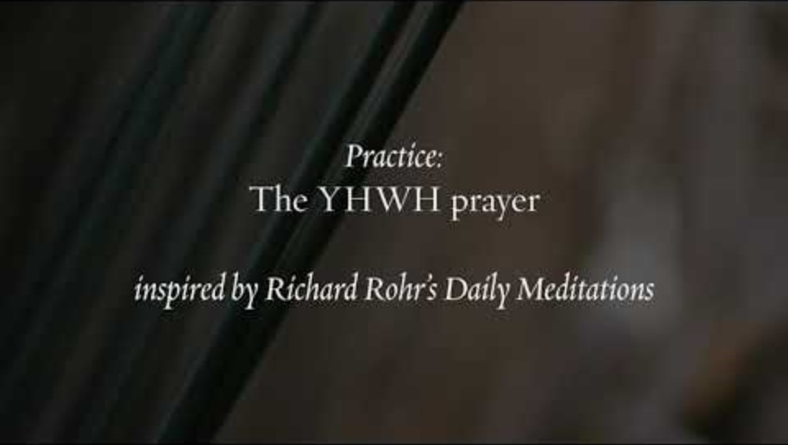

Slide 3
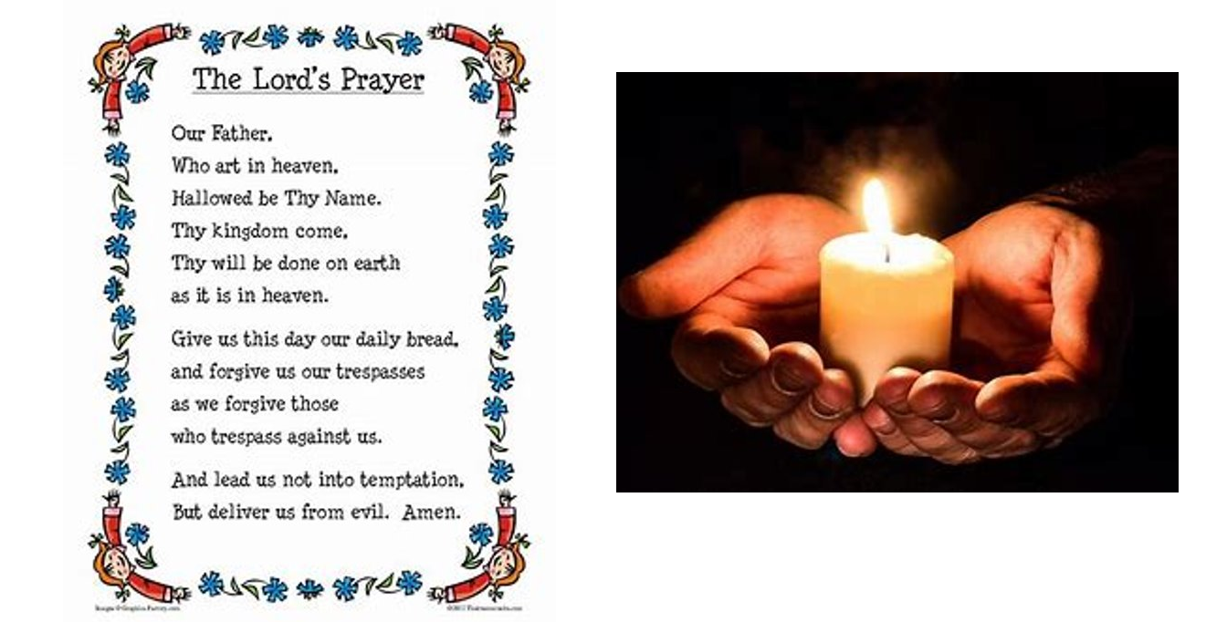

Slide 4
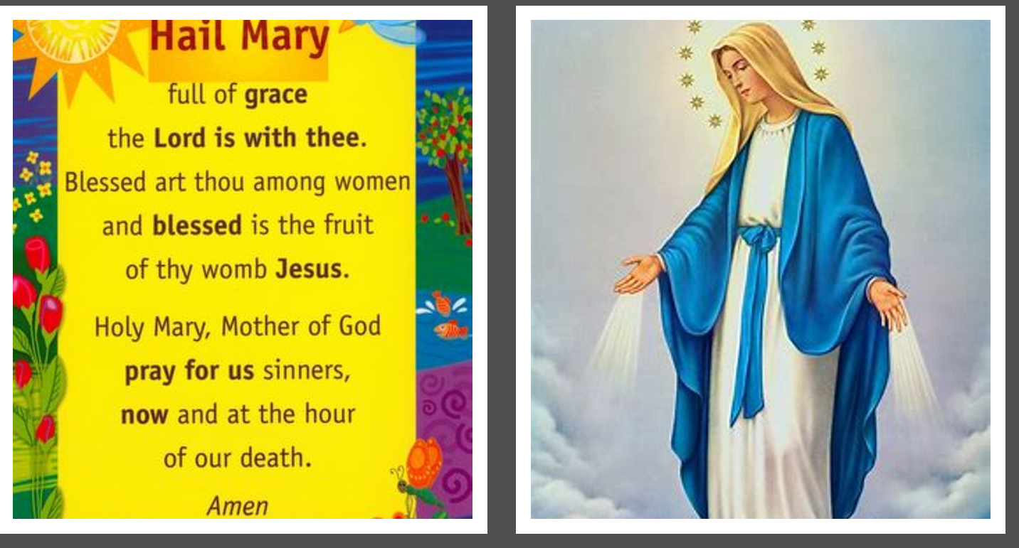

Slide 5
British Values
Respect
Showing respect towards others is important because it shows we value one another as human beings. Respect can be shown in lots of different ways including kindness, support and being polite

Slide 6
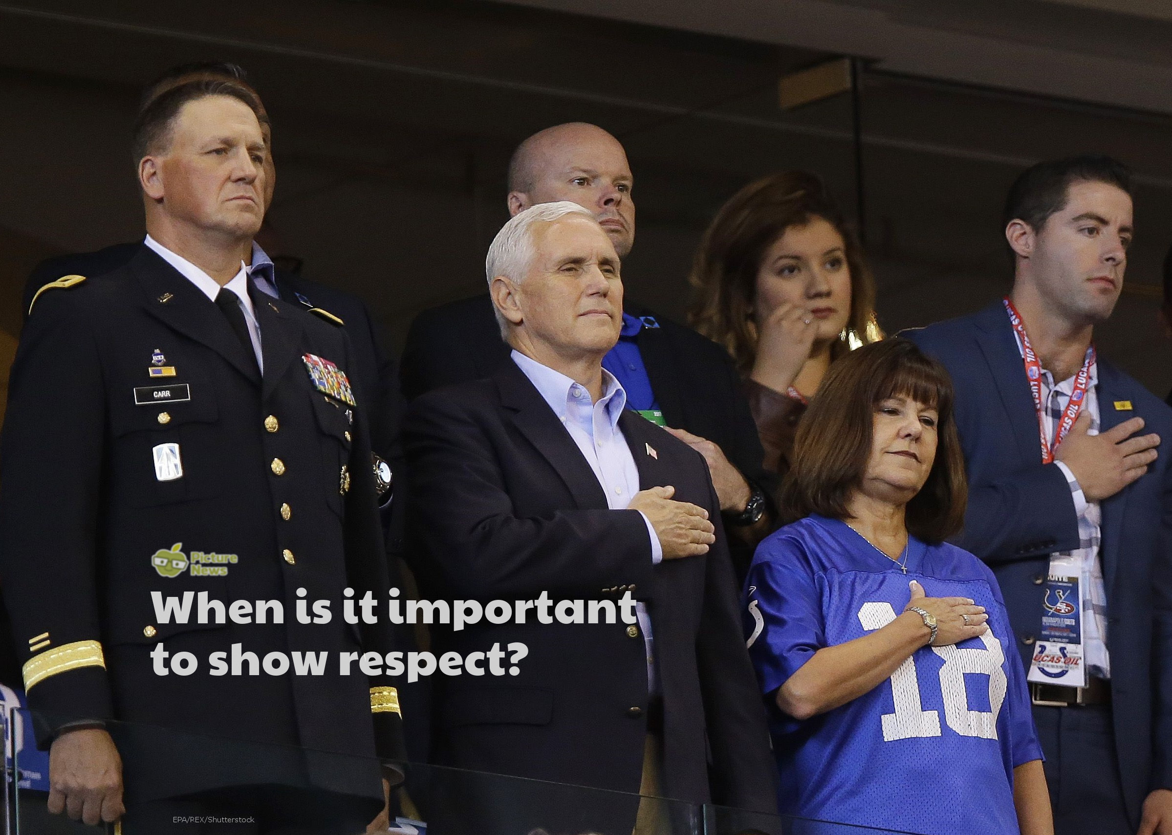

Slide 7
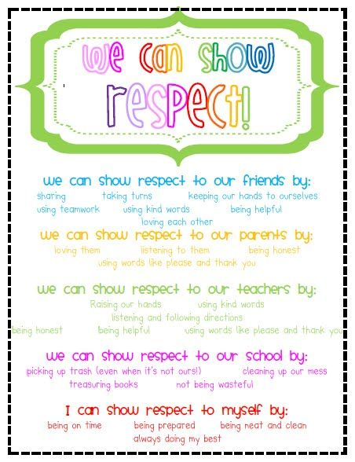
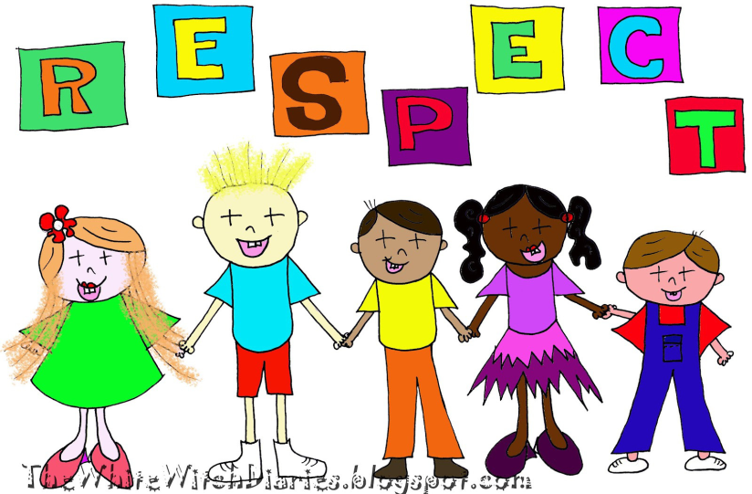
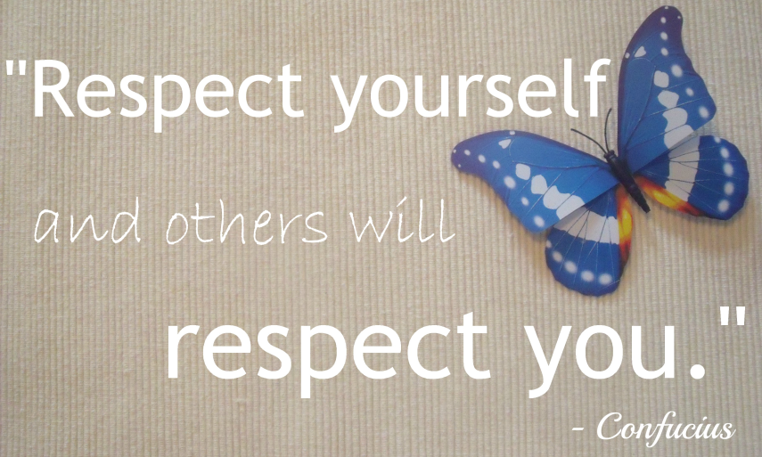
What does RESPECT mean?
Importance of being :
Kind
Helping others
Polite
Equal
Respecting our belongings
Respecting the things that we
have in school.

Slide 8
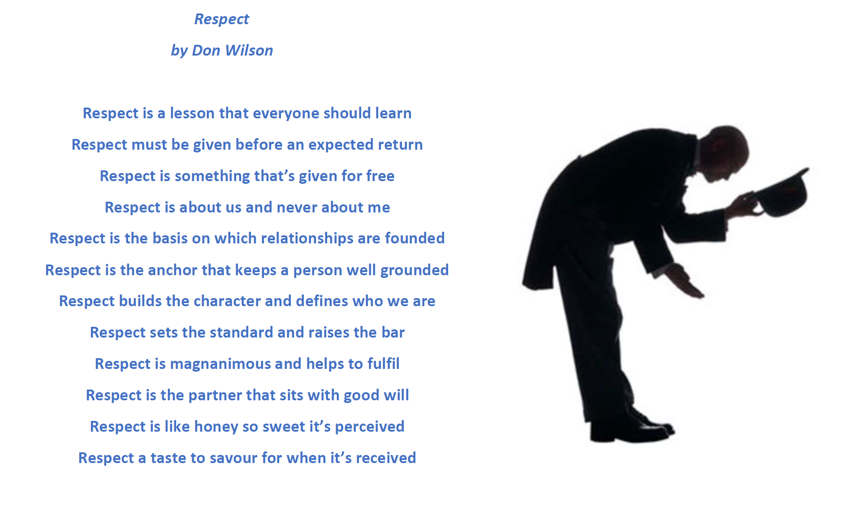

Slide 9
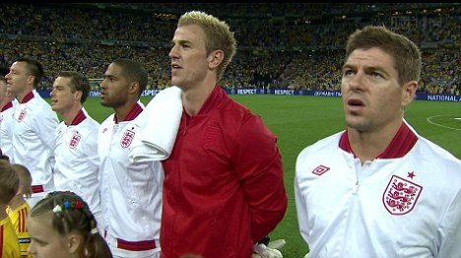
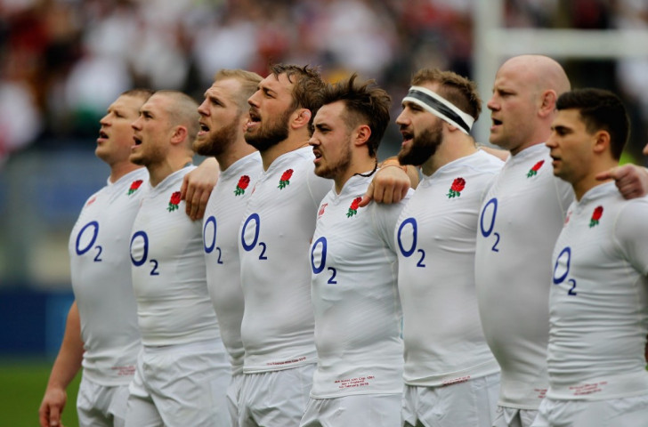
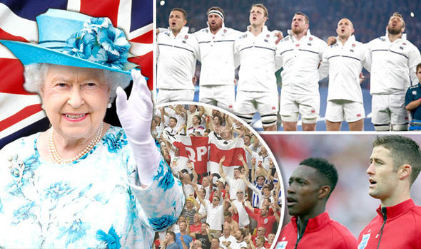
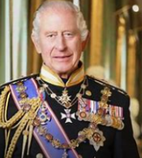
When the National Anthem is sung at a England sporting event – Everyone stands and sings as a sign of Respect.

Slide 10
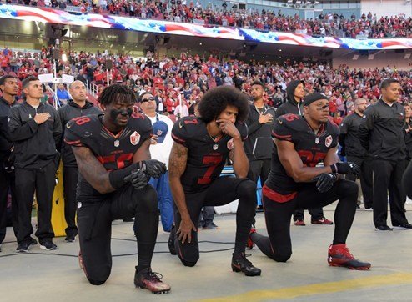
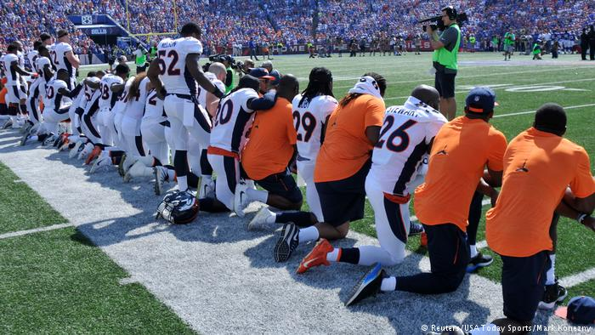
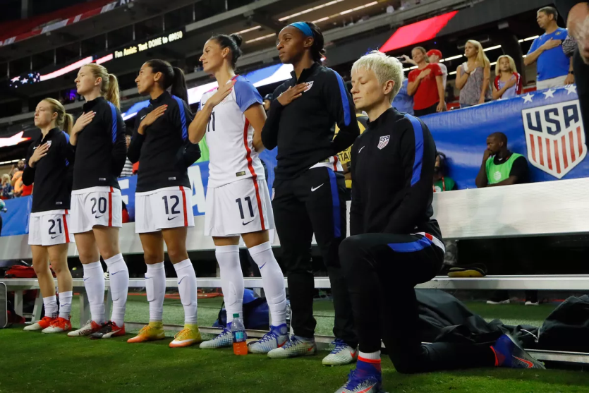
Over many years American sports stars have been objecting against unfairness and police violence in America towards minority groups by kneeling during the National Anthem.
The American President, Donald Trump has said that the sports stars are being disrespectful but the players insist that respect is treating everyone equally which isn’t currently happening.

Slide 11
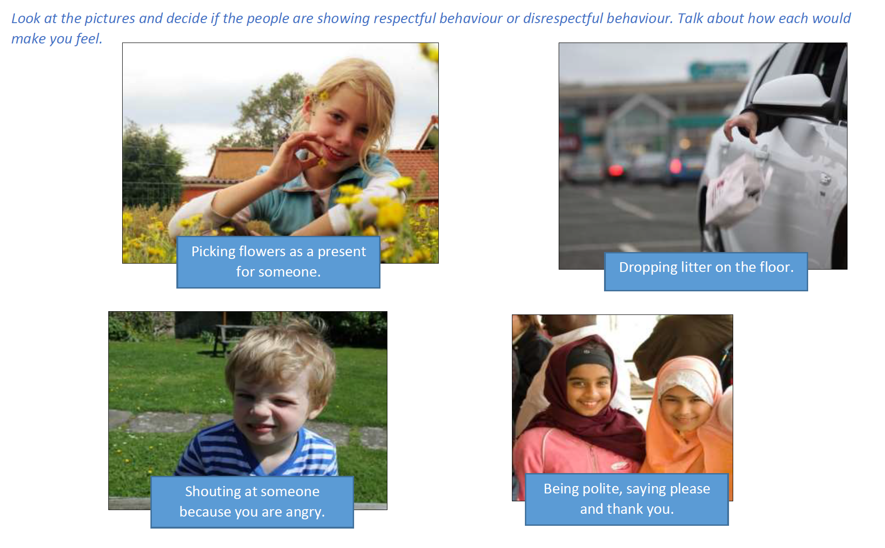

Slide 12
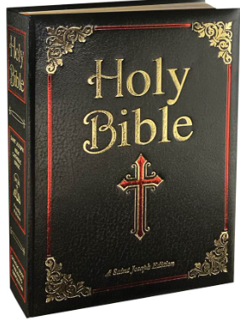
Respect in the Bible
Matthew 7:12
"So in everything, do to others what you would have them do to you, for this sums up the Law and the Prophets."
This verse teaches us to treat others with kindness and respect, just as we would like to be treated.

Slide 13
Let us pray
Dear God,
Respect can be shown in lots of different ways.
Help us to remember that as long as we are considerate, kind and most importantly, treat everyone fairly we will be behaving in a respectful way.
Help us to build a world that is a better, kinder place to live.
Amen

