Slide 1


Mutual Respect for and tolerance of those with different faiths and beliefs and for those without faith.

Slide 2
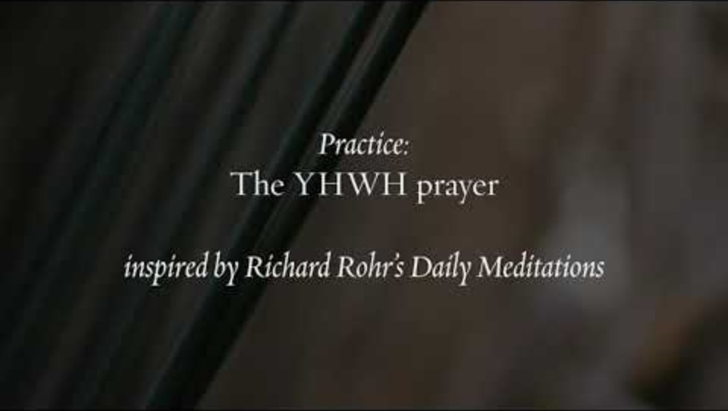

Slide 3
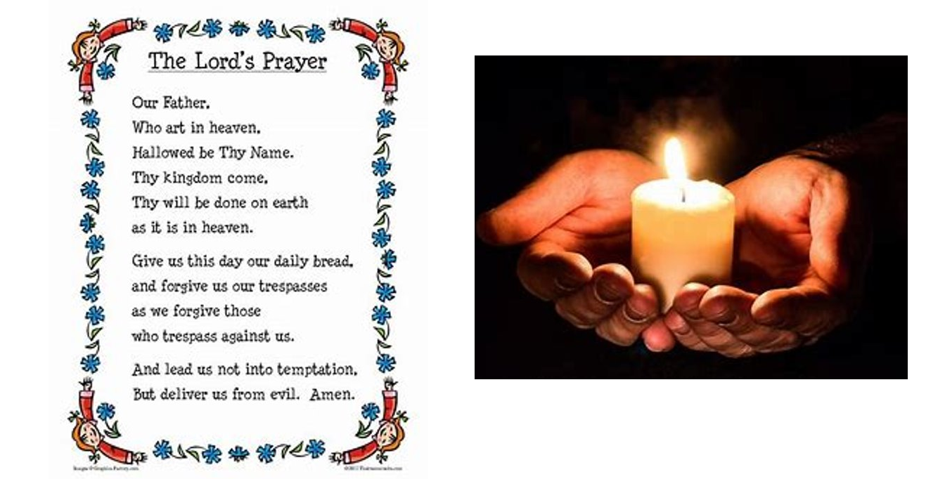

Slide 4
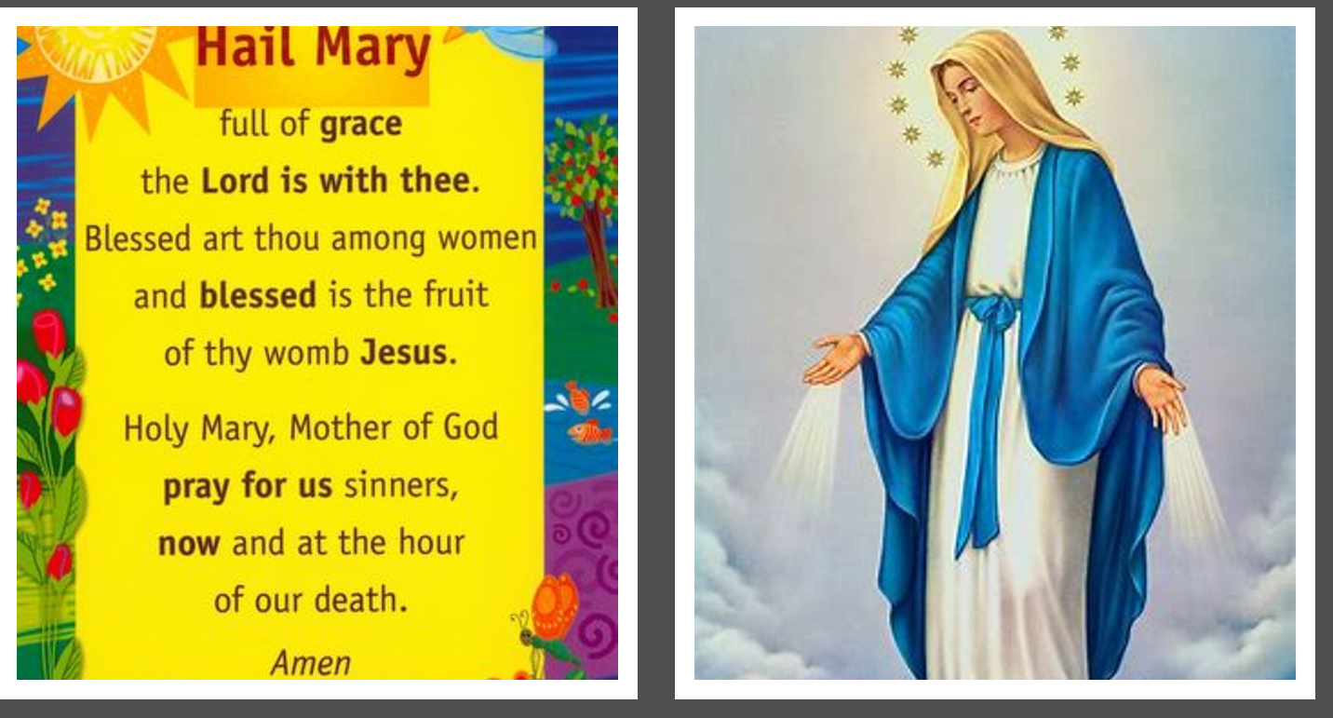

Slide 5
British Values
Individual Liberty
It is up to us how we respond when things go wrongs or become challenging. We can choose to be positive, try our best and keep going for as long as we can! We can choose to be resilient!

Slide 6
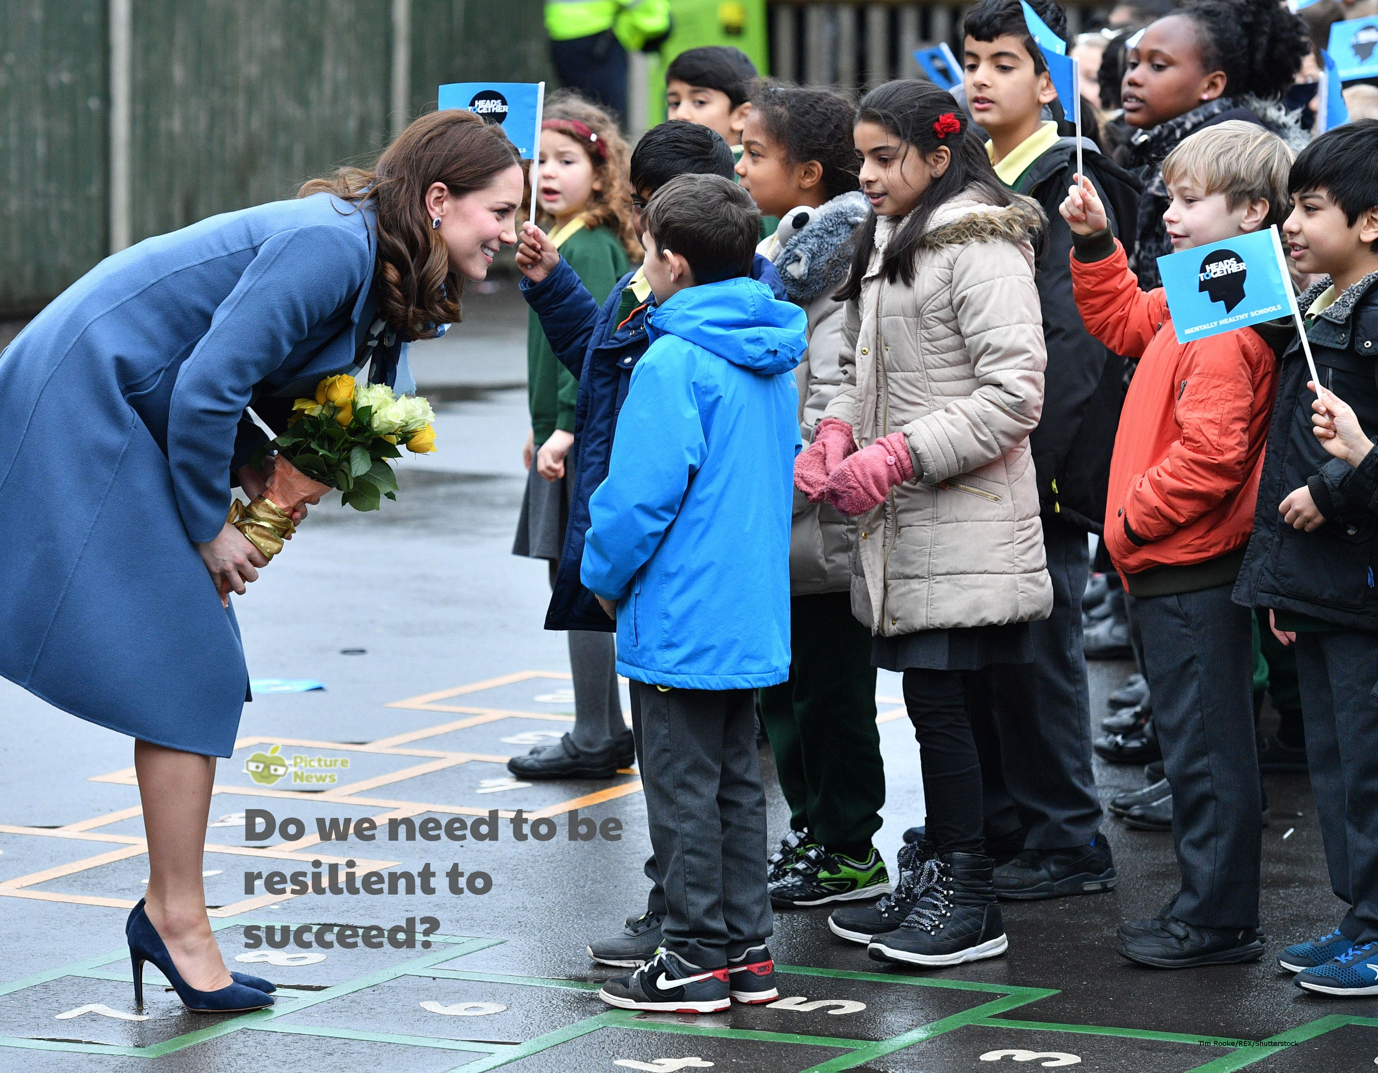

Slide 7
Children’s Mental Health is a very important subject. We have Mental Health Week at school to raise awareness.
MPs regularly meet to discuss children and young people’s mental health.
This is further evidence that children’s mental health has become a matter of concern for everyone.
Each year, more and more children and teenagers are being diagnosed and suffering from mental health problems.

Slide 8
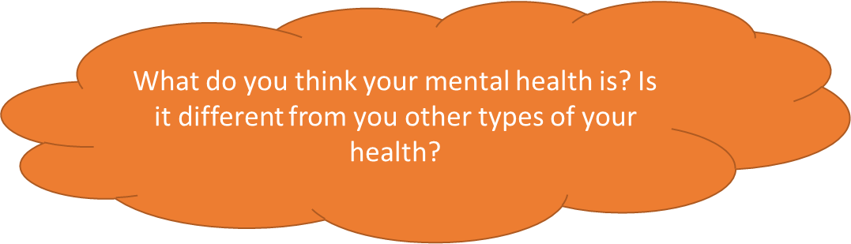
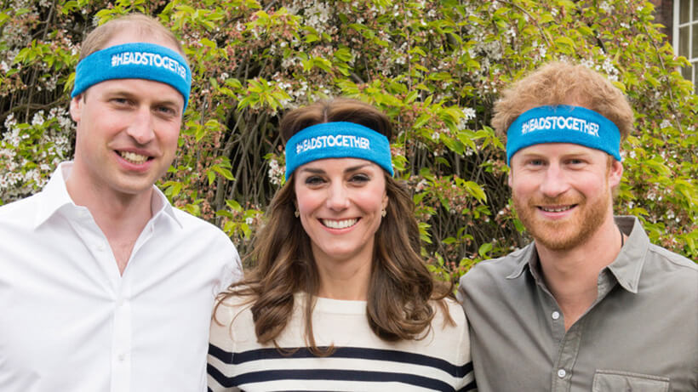
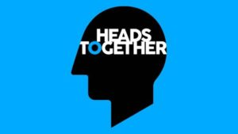
Health ?
Physical Health ? Healthy Eating ?
Mental Health ?
Prince William, the Duchess of Cambridge and Prince Harry work closely with a charity called ‘Heads Together’ which believes in the importance of talking about our thoughts and feelings to help us overcome hard times together.
Difficult things happen to everyone, but the important thing is how we respond to the situation.

Slide 9
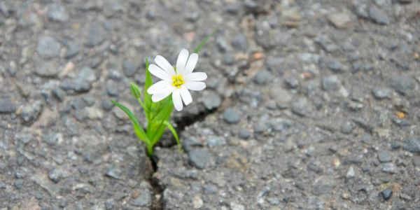
Resilience
A flower growing alone through a crack in the road.
What does resilience mean?

Slide 10

What things do we find difficult?
Do we all find the same things hard?
What do we do when we find things hard?
What can help us keep going when
we find something hard?
Bouncebackability , Perseverance

Slide 11
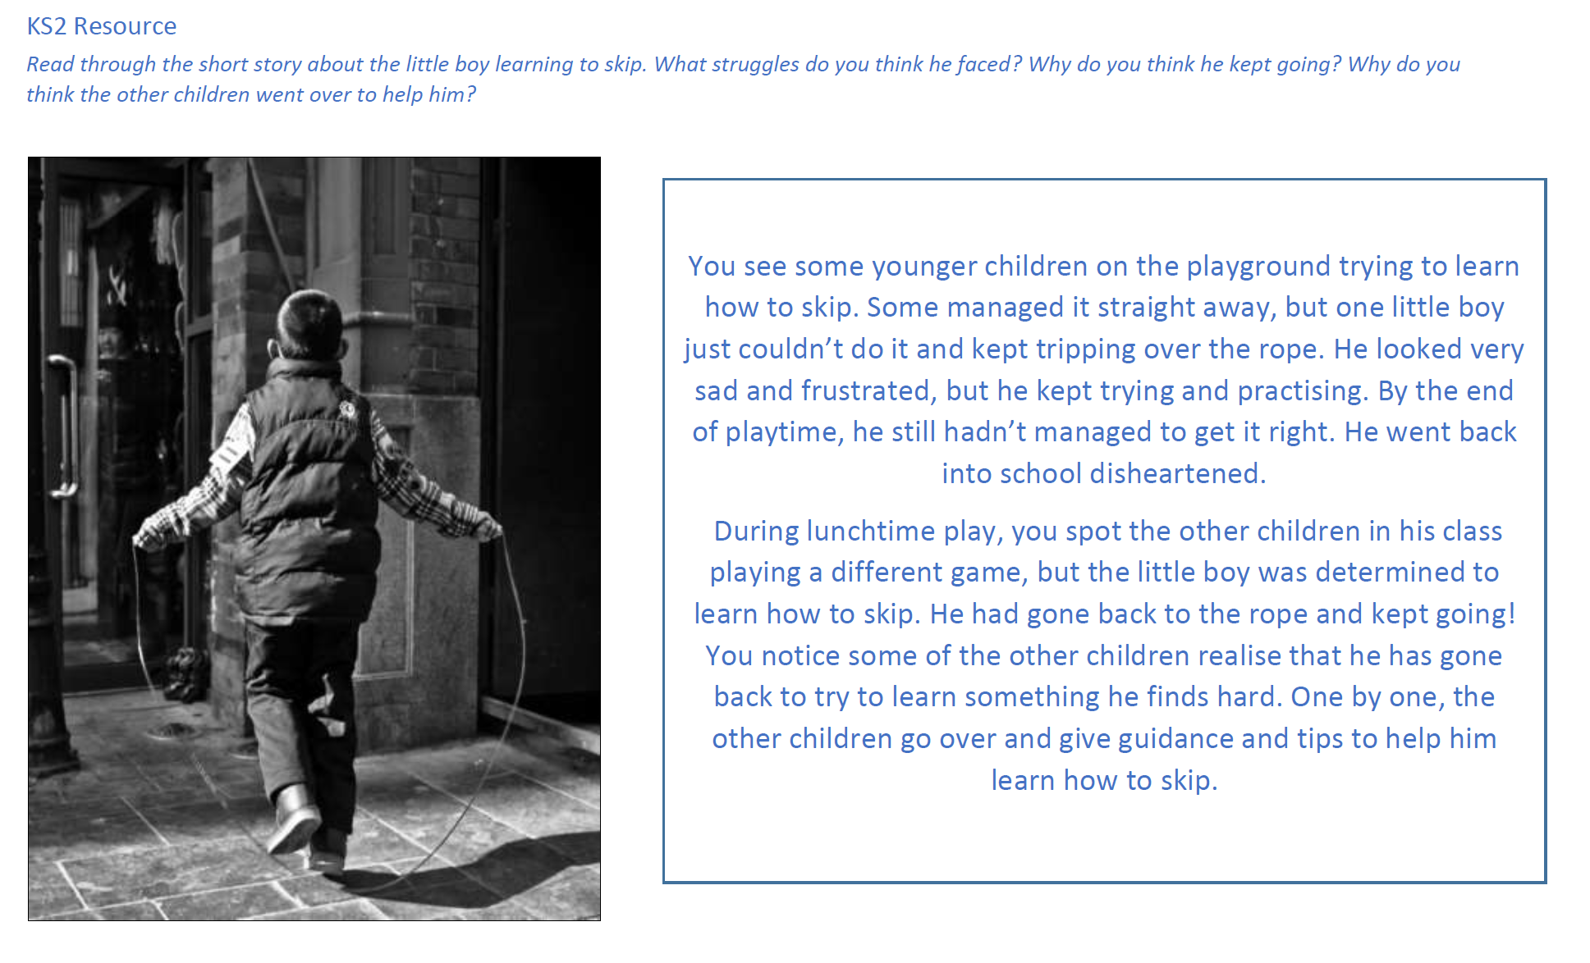

Slide 12
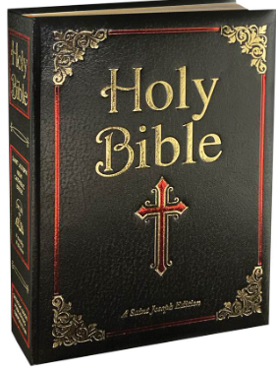
Resilience in the Bible
Joshua 1:9
"Be strong and courageous. Do not be afraid; do not be discouraged, for the Lord your God will be with you wherever you go.“
It teaches us to be resilient, facing challenges with bravery.
It reminds us that God is always with us, giving us strength.

Slide 13
Let us pray
Dear God,
Being resilient isn’t a skill or a talent we are born with, it’s something that we can all choose to be!
Help us to persevere, bounce back, be resilient when things are difficult and not give up, so we can try our very best to reach our goals!
Amen

