Slide 1


Mutual Respect for and tolerance of those with different faiths and beliefs and for those without faith.

Slide 2
May the light of Jesus be in our hearts
Learning and loving on our journey with Jesus

Slide 3
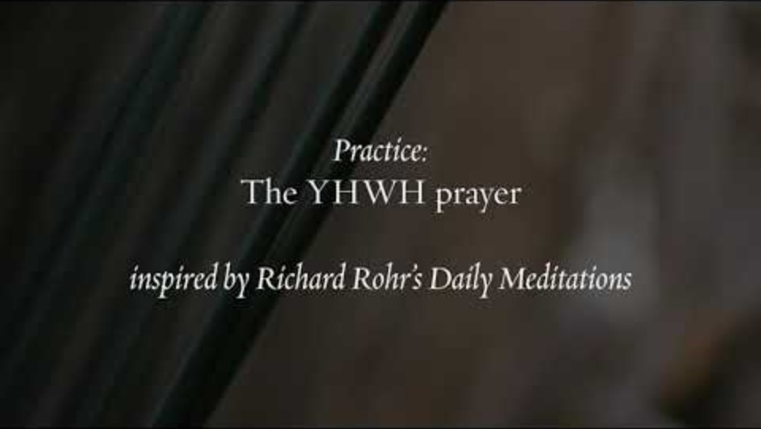

Slide 4
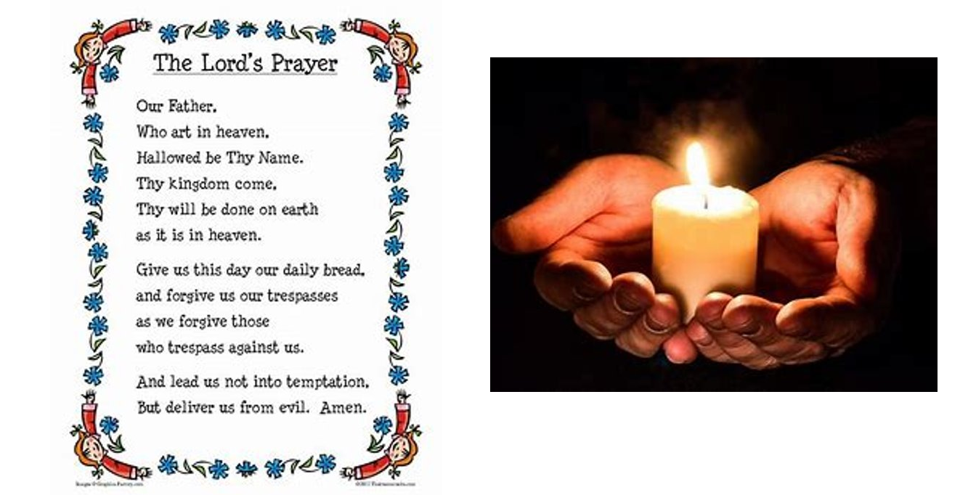

Slide 5
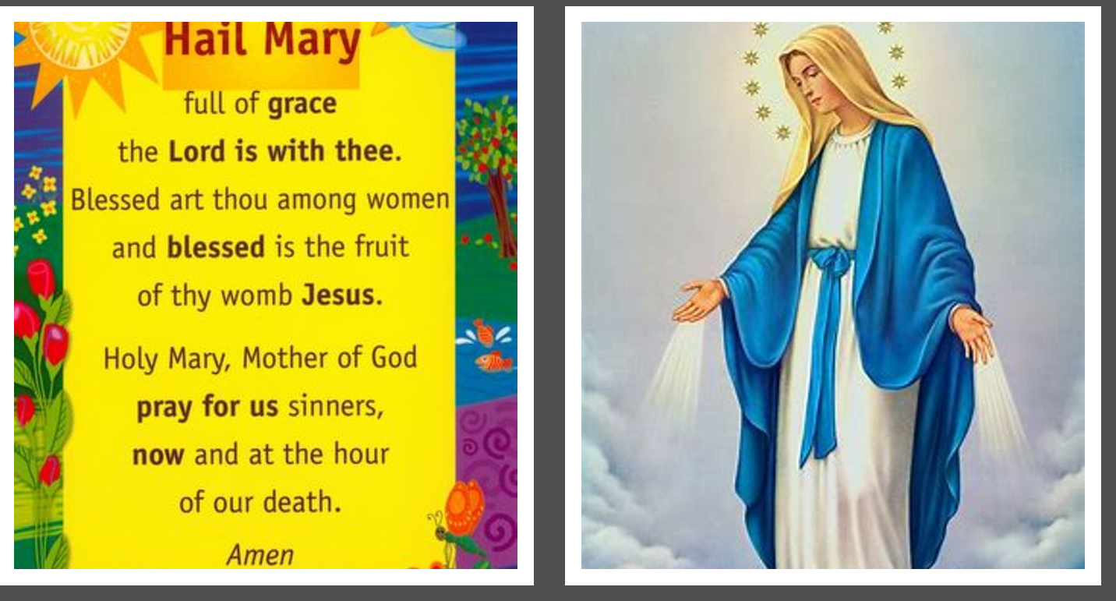

Slide 6
British Values
Mutual Respect
We will celebrate both our own achievements and those of our role models

Slide 7
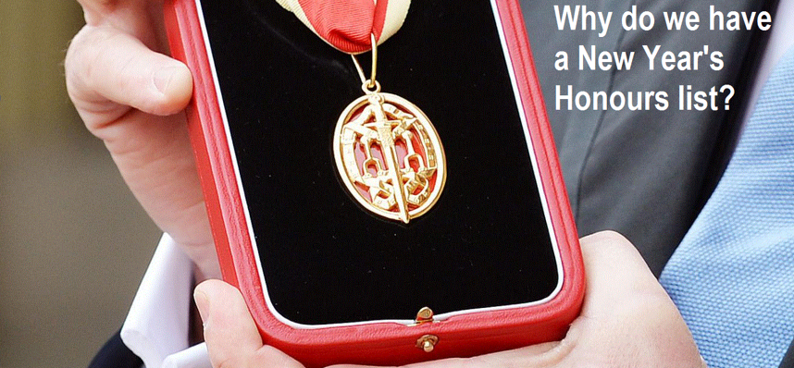

Slide 8
British citizens who have achieved extraordinary work in public life may receive an honour from the Queen as part of the New Year’s Honours list, released each year.
Each person who has received an award has been nominated by someone else and they most likely wouldn’t have even been aware!
People are nominated for achievements like making a difference to their community, being a volunteer for a long time or being very good and dedicated to their job.

Slide 9
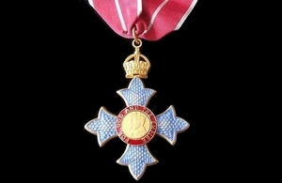
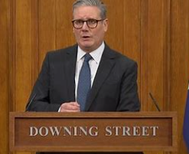
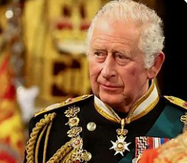
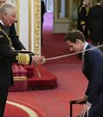
Can you think of anyone who deserves one?
Anyone can be nominated but only a few are selected.
Once the list has been chosen, the Prime Minister sees the list and then it is sent to the King to check it.
The winners then receive their awards, which are special medals, from a member of the Royal Family at a very special event.
The awards have been running for a very long time, why do you think they are still going and do you think they are important.

Slide 10
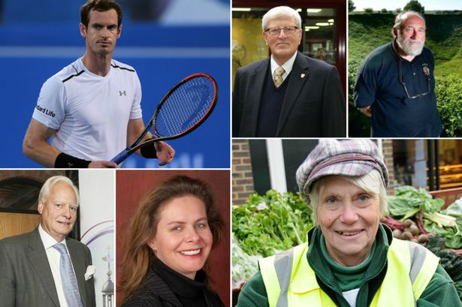
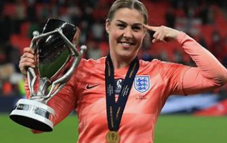
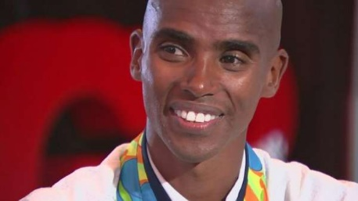
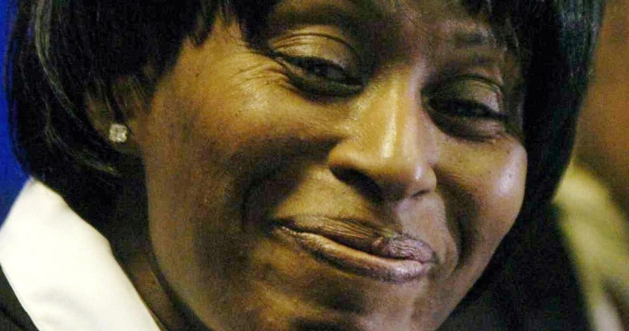
If you look through the list you will see people from a wide range of backgrounds, including lots of film stars and sporting heroes as well as people who aren’t famous at all. It is important to recognise all achievements however big or small!

Slide 11
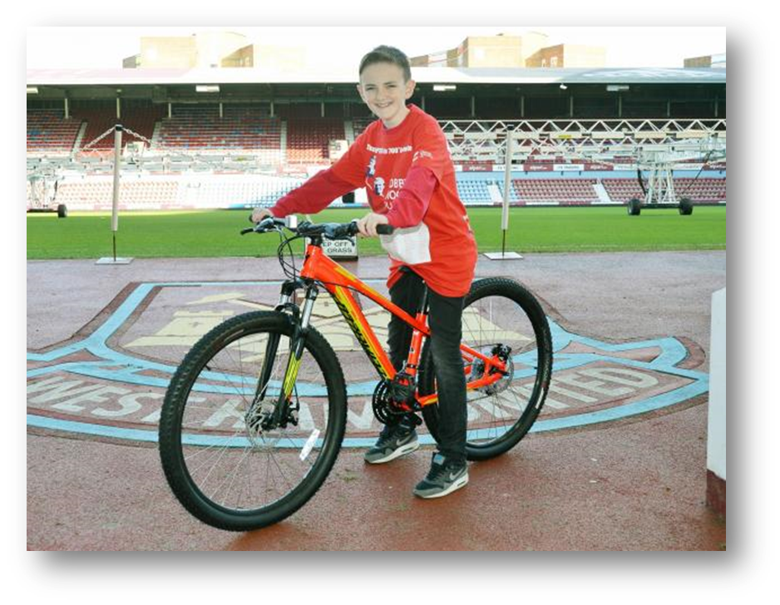
Who has received honours in the past?
Who? 13 year-old John Joe Huerman received an OBE (Order of the British Empire) medal in 2016 after raising £235,000 for a charity after his Grandma died of cancer.
How? He cycled 700 miles to visit all the Premier League football clubs in England and the walked 50 miles to the rest of the London clubs.

Slide 12
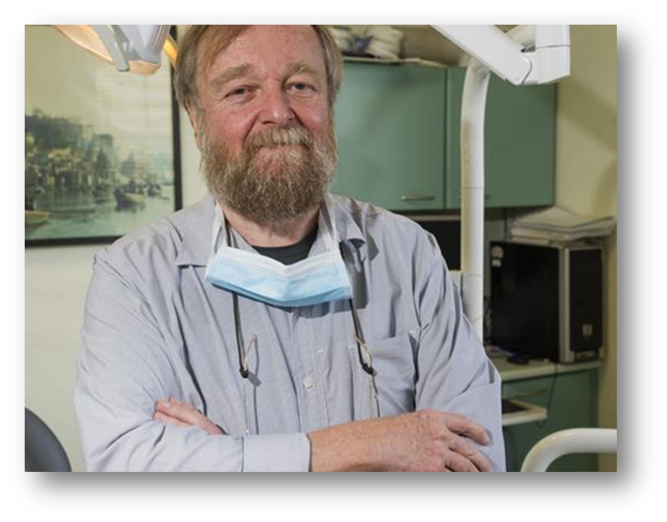
Who? Dentist Dr Ashley Lupin spent many years travelling to Bwindi in Africa to work as a dentist to help local communities there.
How? Dr Ashley used his own money to fund his trips and helped raise money to set up a hospital. He even helped train a young man to qualify as a dentist.

Slide 13
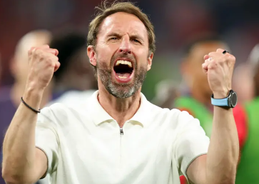
Southgate is the fourth England manager to be knighted, following Sir Walter Winterbottom, Sir Alf Ramsey and Sir Bobby Robson.
FA chair Debbie Hewitt said Southgate had "embodied the best of English football".
"He brought our fans closer than ever to the team, stood up for what he believed in and inspired players to share his pride in representing England," she said.

Slide 14
Who do you think is a good role model?
Role models are very important as we look up to them, admire them and often copy what they do.
We must be sure to choose our role models carefully, not just because they are rich or famous but because they provide great examples of how to live.

Slide 15
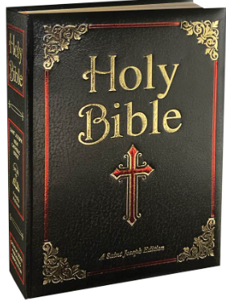
Mutual Respect in the Bible
Romans 12:10
"Be devoted to one another in love. Honor one another above yourselves.“
This verse teaches us to show kindness, respect, and love to everyone, putting others before ourselves and treating them with dignity. It reminds us that respect is not just about being polite, but about valuing each person as special and important.
This message connects well with mutual respect, encouraging us to listen to others, accept differences, and treat people the way we would like to be treated.

Slide 16
Let us pray
Dear God,
Thank You for making each of us special and unique.
Help us to treat everyone with kindness and respect,
to listen, to be fair, and to value others' thoughts and feelings.
Teach us to love one another as You love us.
Amen.

