Slide 1


Mutual Respect for and tolerance of those with different faiths and beliefs and for those without faith.

Slide 2
May the light of Jesus be in our hearts
Learning and loving on our journey with Jesus

Slide 3
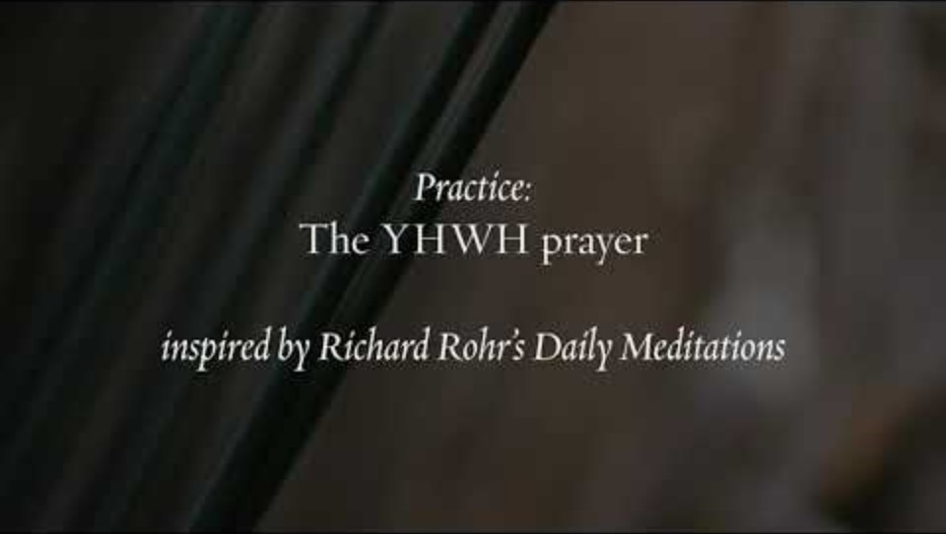

Slide 4
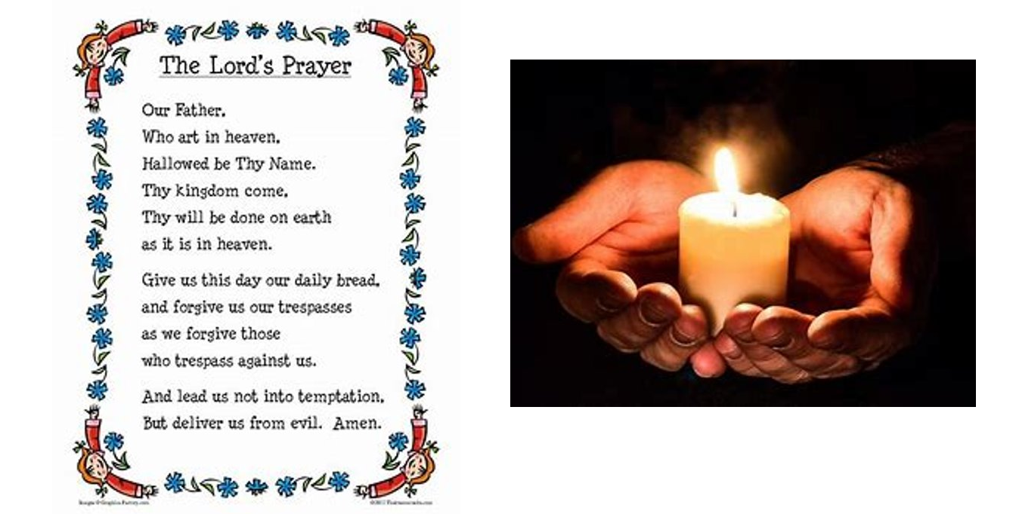

Slide 5
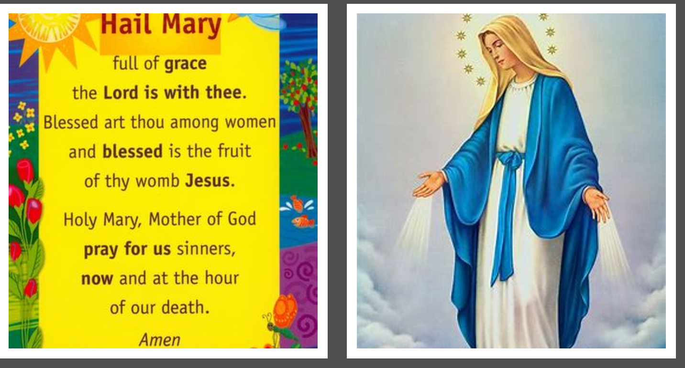

Slide 6
British Values
Respect
We understand the importance of conserving special places and will show respect for these places

Slide 7

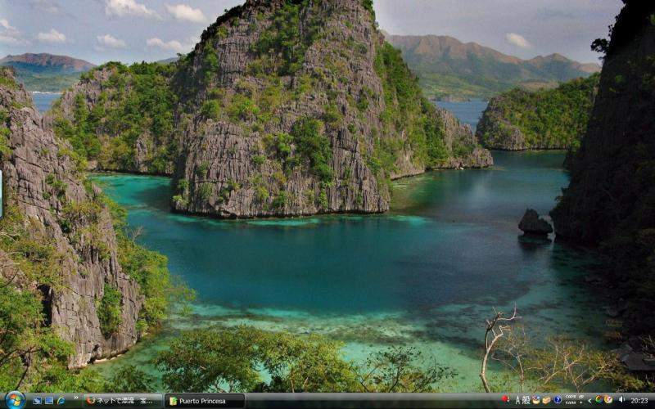
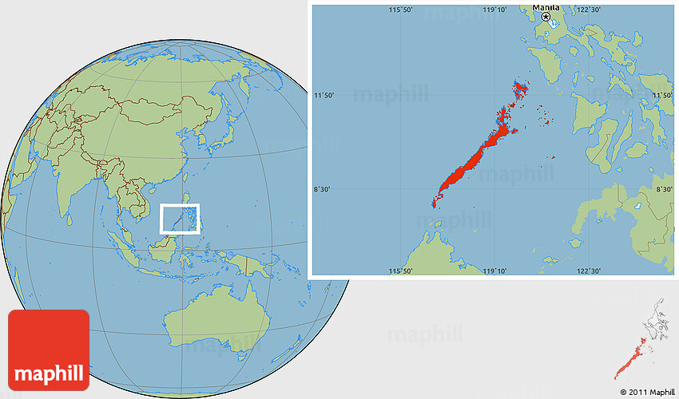
Conservation
In 2017, the Philippine environment minister has said that the American children’s television channel ‘Nickelodeon’ will not be allowed to build an underwater theme park on one of the country’s protected islands.

Slide 8
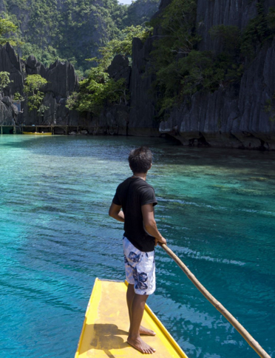
Should we be allowed to build anywhere?

Slide 9
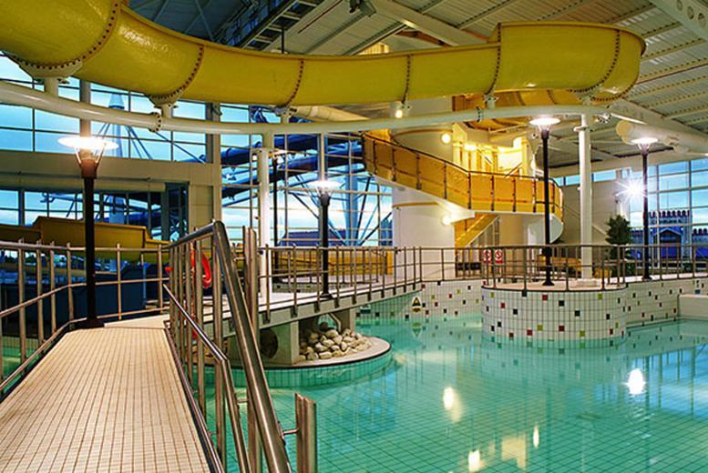
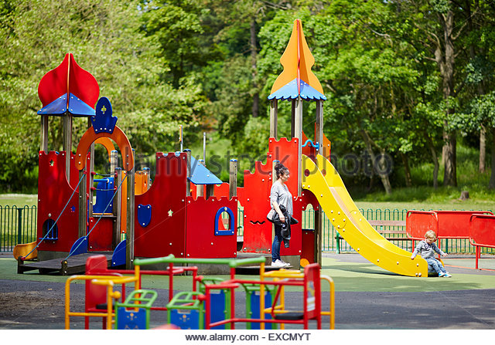
Special Places
Have you got a special place ?
It could be home/school a favourite park or swimming pool.
What is it that makes these places special?

Slide 10

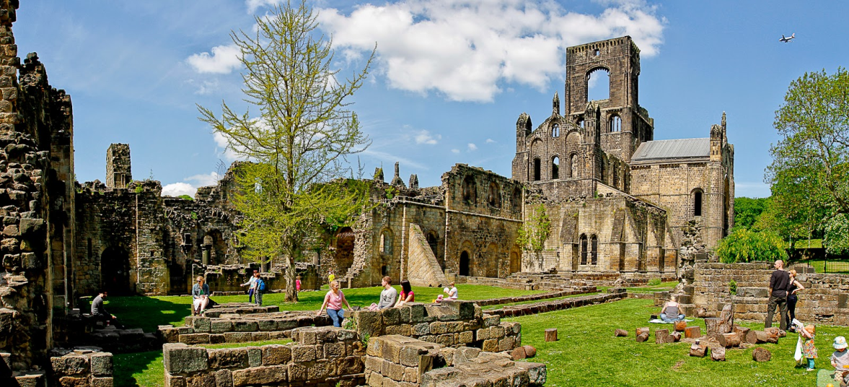
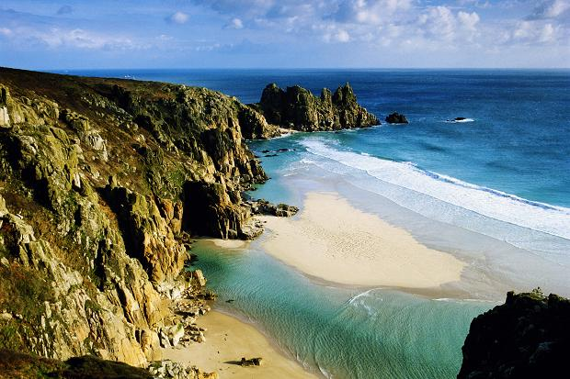
What makes these places special?
Kirkstall Abbey, Leeds
What makes these places special? Why do we not allow any new buildings to be built near them?
Lands End, Cornwall

Slide 11
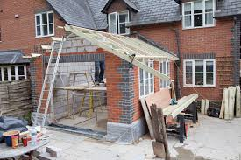
Have you ever had an extension on their house or experienced building a new house?
There are many processes of planning permission, which take time. Lots of important people make decisions on whether it’s ok for the building work to start. Is this a fair and a good way to reach a decision?

Slide 12
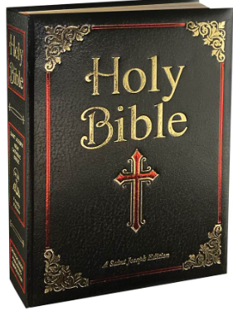
Respect in the Bible
1 Corinthians 3:16-17
"Don’t you know that you yourselves are God’s temple and that God’s Spirit dwells in your midst? If anyone destroys God’s temple, God will destroy that person; for God’s temple is sacred, and you together are that temple."
This passage reminds us to respect places of worship and the spaces that hold special meaning. Just as we should care for churches, schools, and community buildings, we should also respect one another, as we are all part of God’s creation.

Slide 13
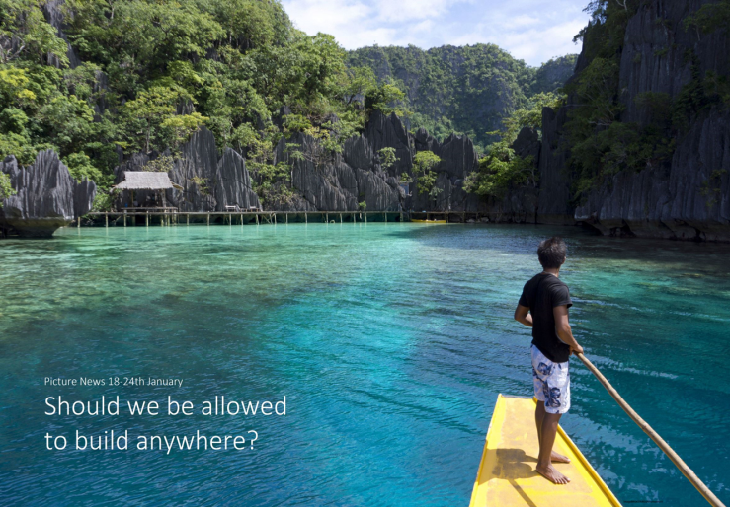
Prayer
Dear God
There are lots of special places not just around where we live but all over the world.
So we can enjoy them, please help everyone to look after them so that future generations can enjoy them as we have.
Amen

