Slide 1

Welcome to Friends of St Mary’s (FOSM)

Slide 2




Welcome to your PTFA
What is the PTFA?
The Parents, Teachers & Friends Association is an open community of parent volunteers working alongside the school, teachers and other “friends” to benefit the school and ensure the best educational experience for all its pupils. We are a small charity that is governed independent from the school.
All parents and carers at St Mary’s Catholic Primary school are automatically a member now that your child has enrolled in the school. It’s your association.

Slide 3




How do we benefit the school?
Parents and care givers have a big impact on how well their kids do at school. Taking an active role in FOSM is one of the ways you can make a difference and get involved.
Through FOSM we:
Raise money to fund school initiatives through charity activities and events
Provide a social support network for parents and carers
Offer volunteering opportunities so you can support your child’s learning

Slide 4


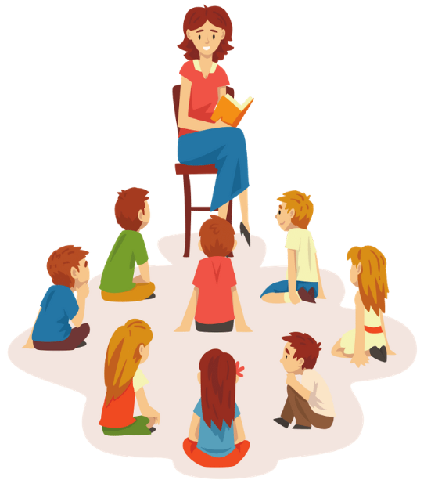
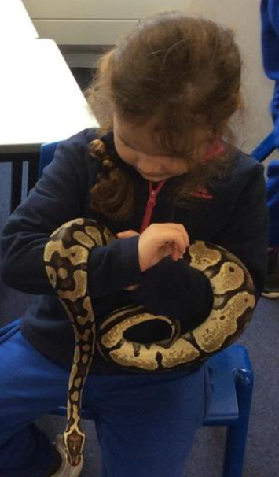
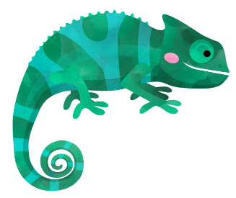
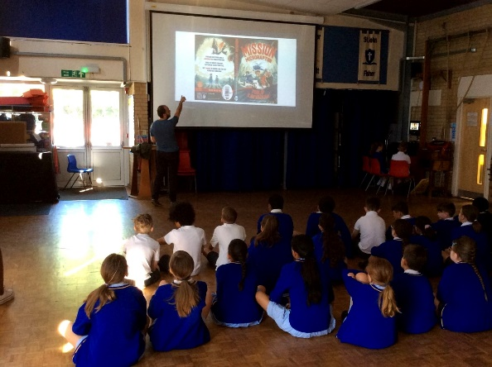
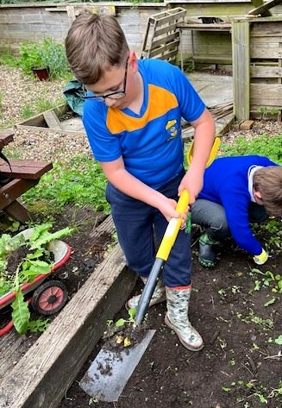

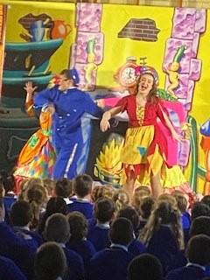
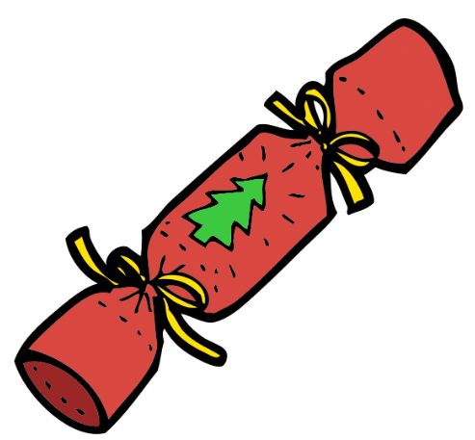
Friends Of St Mary’s have funded:
Author visits to inspire
our children’s literacy
A library space for our children;
Refurbishment & new furniture
alongside new books to support
our Assisted Reader scheme
Reptile
visits to
support
Science Week
Festive Fun with
Christmas crackers
& a Pantomime
Cases to protect
the school’s
new iPads
Supplies and materials so that our
children and Eco Garden can thrive

Slide 5
We love to have fun…
Disco’s
Secret Santa Shopping Days
Please join us for:
Winter Fair
Summer Fair
Saturday 22nd June, 12-3pm.
Bring a picnic and enjoy the entertainment
After school ice lollies
Bingo Night
Welcome Picnic & Games
Theatre Trips
Sunday 15th September, Save the Date!
Meet classmates and new families with a few fun games for the children.
Easter Event
Tea & Tissues
Join us for a cuppa after that first day drop off! Details to be confirmed.

Slide 6
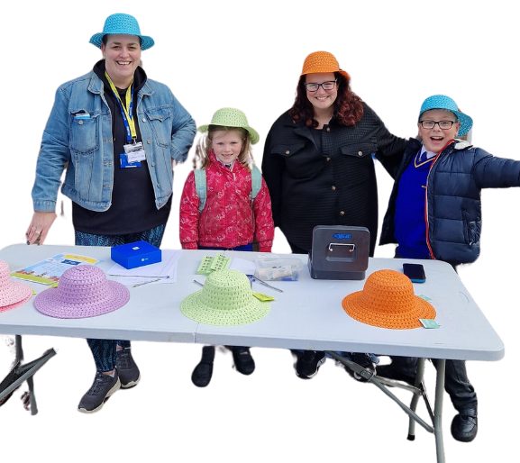
We rely on volunteers…
Every parent, carer or teacher has value to bring!
Content creation
Gardening or manual labour
Balancing
the books
Reaching out for sponsorship
Providing first aid cover
Handing out flyers
Event management
Wrapping
lucky dip gifts
Selling raffle tickets
Selling ice lollies
Sharing your bright ideas!
And much much more!
…and you don’t need to be on the committee to help!
Some of our most active parents work full time or have other commitments
You can help behind the scenes, or at an event as often or as little as you like
We all have lives away from school, and it’s OK to say “no”
Or you can join us on the committee & be part of the magic!

Slide 7
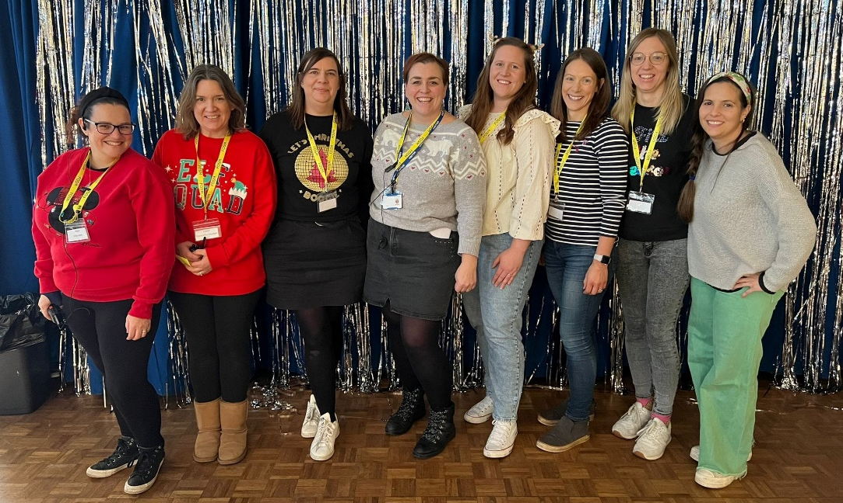
It’s more than just fundraising, it’s our school community…
For info on activities and events:
Sign up to our website, buy tickets and volunteer at:
www.pta-events.co.uk/fosm-maidenhead
Join our Facebook Page: St. Mary’s – Maidenhead – Community Page
Or drop us an email directly:
  fosmhub@gmail.com

