Slide 1
Teach reading: change lives
Parent workshop: Phonics and early reading in Reception, Phase 2
(Autumn 1)
Notes:
For this presentation, you will need to download and print out the following resources and information for parents:
Phase 2 grapheme information sheet – Autumn 1
the parent handout ‘Your child’s reading journey – Reception Autumn term’
the Phase 2 and 3 grapheme mat
the Little Wandle Progression overview
‘Phase 2 tricky words: Reception Autumn term – Information for parents and carers’ – or parents can access this in the ‘For parents’ area of the Little Wandle website.
You will need a flipchart and access to the Little Wandle and Collins websites.
You may also wish to have a copy of the Little Wandle Glossary to hand (in Getting started/Teaching).

Slide 2
A love of reading is the biggest indicator of future academic success.
OECD (The Organisation for Economic Co-operation and Development)
Notes:
Slide purpose:
To share the link that research has established between loving reading and being successful academically
Suggested script:
Let's start our session with a quote from the Organisation for Economic Co-operation and Development ...
Read the quote.
This quote reminds us of the importance not just of teaching children to read, but also of teaching them to love reading.
Today, we're going to talk about phonics, but we always see phonics as the route into reading and a love of reading as the ultimate goal of phonics teaching.

Slide 3




How many times have you already read today?
Notes:
Slide purpose:
To help parents see the value of reading by getting them to reflect on their own reading experiences
Suggested script:
Just think about how many times you have already read things today. More than ever, we are surrounded by text and reading is a vital skill.
We want all of our children to become confident readers who can navigate the world of reading around them.

Slide 4

Reading and spelling

Slide 5
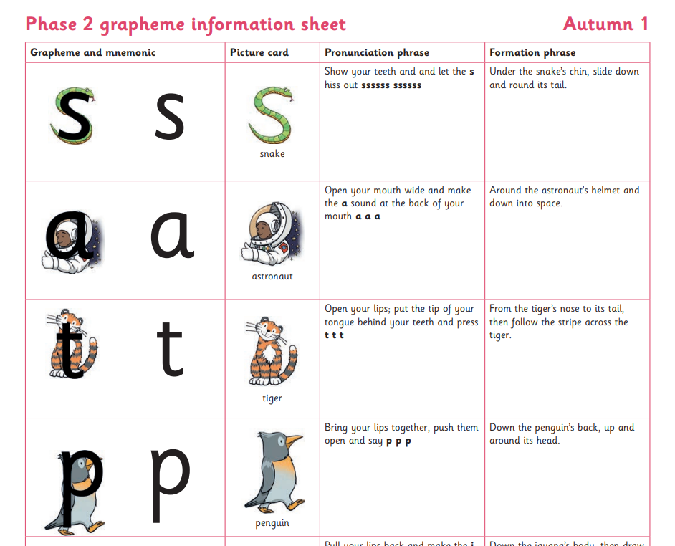

Spelling
Your child will be taught how to spell simple words, using the graphemes they have been taught.
They will practise the correct formation of letters. They will also have handwriting lessons.
Notes:
Slide purpose:
To introduce spelling
Notes:
Read the slide.
Hand out the Phase 2 grapheme information sheet for Autumn 1, which includes the formation phrases.

Slide 6

How do we teach spelling?
Say the word.
Segment the sounds.
Count the sounds.
Write them down.
Notes:
Slide purpose:
To provide an overview of spelling
Notes:
Model the process above on a flipchart for the parents to see.
Show the process with a Phase 2 word, e.g. pin, dig, hug.

Slide 7
How do we practise reading in books?
Reading practice sessions are:
timetabled three times a week
taught by a trained teacher/teaching assistant
taught in small groups
children in Reception will bring a book home by week 4 of the first half-term.
Notes:
Slide purpose:
To introduce decodable books
Suggested script:
The children read the same book three times in a week.
The first time we work on decoding (sounding out) the words, the second time we work on prosody which is reading with expression – making the book sound more interesting with our story-teller voice or our David Attenborough voice – and the third time we look at comprehension.
We read the books three times at school because we want to develop the fluency.
The more children see words, the more they begin to read them automatically without having to sound them out.

Slide 8

How do we find the right book for your child?
Notes:
Slide purpose:
To introduce book matching
Suggested script:
We assess your child every six weeks to check progress.
Any child who needs extra support has Daily Keep-up sessions planned for them.

Slide 9
Reading at home

Slide 10

Books going home
Notes:
Slide purpose:
To introduce the process and format for reading at home
Suggested script:
As well as the ‘learning to read’ book that your child will bring home they will also bring home a book for sharing with you.
This shared book is SO important. This is how we are going to give them the WILL to read.
Please read with your child as often as you can – at least once a day if possible.

Slide 11
Listening to your child read their phonics book
Your child should be able to read their book without your help.
They might sound out words and blend them before they read them fluently.
If they can’t read a word, read it to them.
Talk about the book and celebrate their success.
Notes:
Slide purpose:
To give guidance on reading the decodable book at home
Notes
Read the slide.

Slide 12
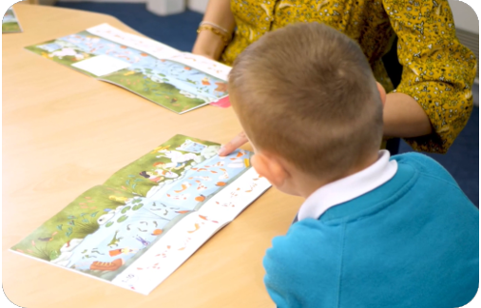
Reading a wordless books
Wordless books are invaluable as they teach reading behaviours and early reading skills to children who are not blending – yet!
Talk about the pictures.
Point to the images in the circles and find them on the page.
Encourage your child to make links from the book to their experiences.
Notes:
Slide purpose:
To give guidance on reading wordless books at home
Notes:
Read the slide.

Slide 13

Read to your child
The shared book is for YOU to read:
Make the story sound as exciting as you can by changing your voice.
Talk with your child as much as you can:
  Introduce new and exciting language.
  Encourage your child to use new vocabulary.
  Make up sentences together.
  Find different words to use.
  Describe things you see.
Notes:
Slide purpose:
To give guidance on reading the shared book at home
Notes:
Read the slide.

Slide 14

Supporting your child with phonics
Notes:
Slide purpose:
To give guidance on supporting phonics learning at home
Suggested script:
It is really important that you pronounce the sounds correctly at home if you are supporting your child.
Use the videos we saw earlier for support.

Slide 15

The most important thing you can do is read with your child
Reading a book and chatting had a positive impact a year later on children’s ability to…
understand words and sentences
use a wide range of vocabulary
develop listening comprehension skills.
The amount of books children were exposed to by age 6 was a positive predictor of their reading ability two years later.
Parental involvement in the development of children’s reading skills: A five-year longitudinal study (2002) Senechal, M. and Lefvre, J
Notes:
Slide purpose:
To summarise key takeaways
Suggested script:
Celebrate your child’s success at school.
Make time for reading at home!

Slide 16
One of the greatest gifts adults can give is to read to children
Carl Sagan
Notes:
Slide purpose:
Key takeaways/final message
Notes:
Read the quote.

