Slide 1

Welcome to our phonics information sharing session

Slide 2
Phonics and Early Reading
Part 1 – how we teach phonics
Part 2 – how we teach reading
Part 3 – supporting at home

Slide 3
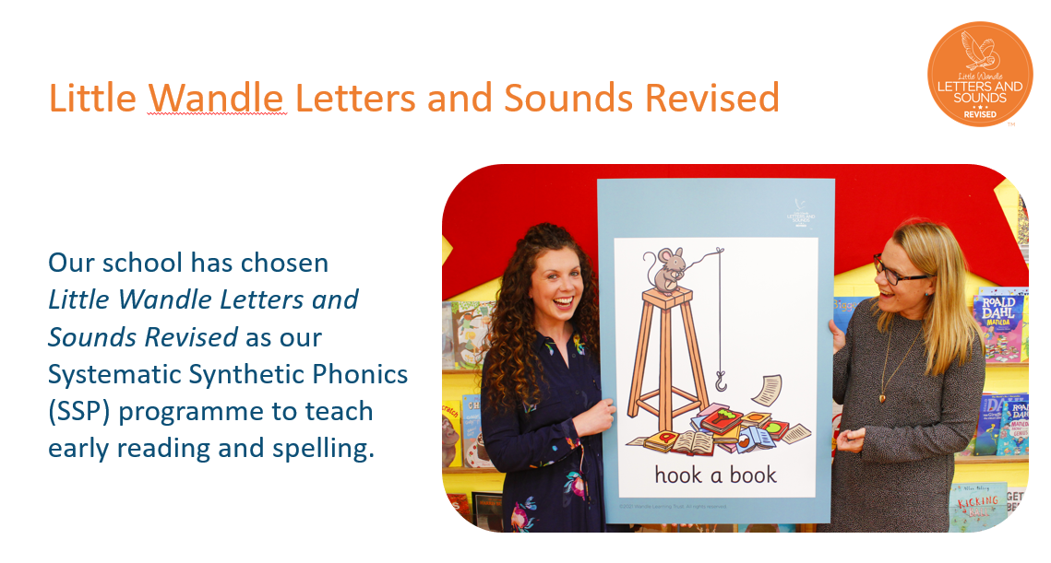
https://www.littlewandlelettersandsounds.org.uk/

Slide 4

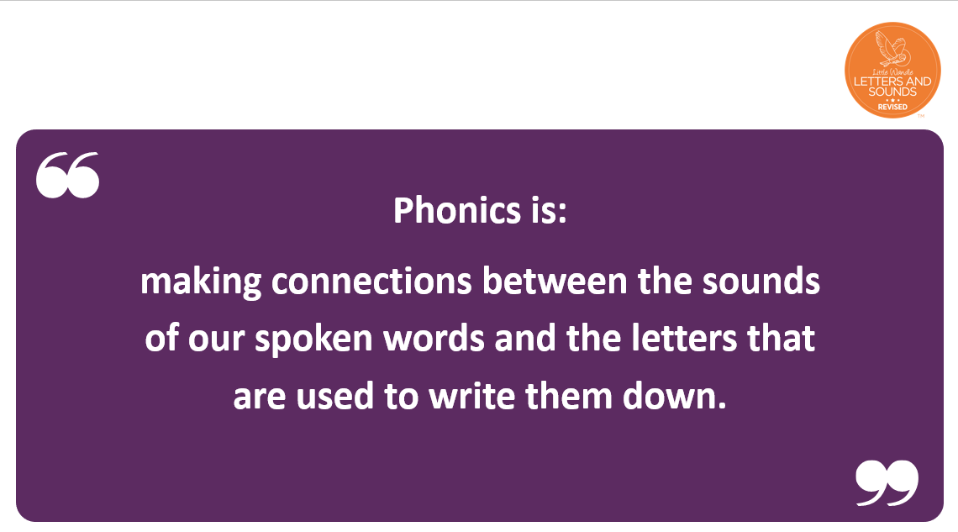

Slide 5
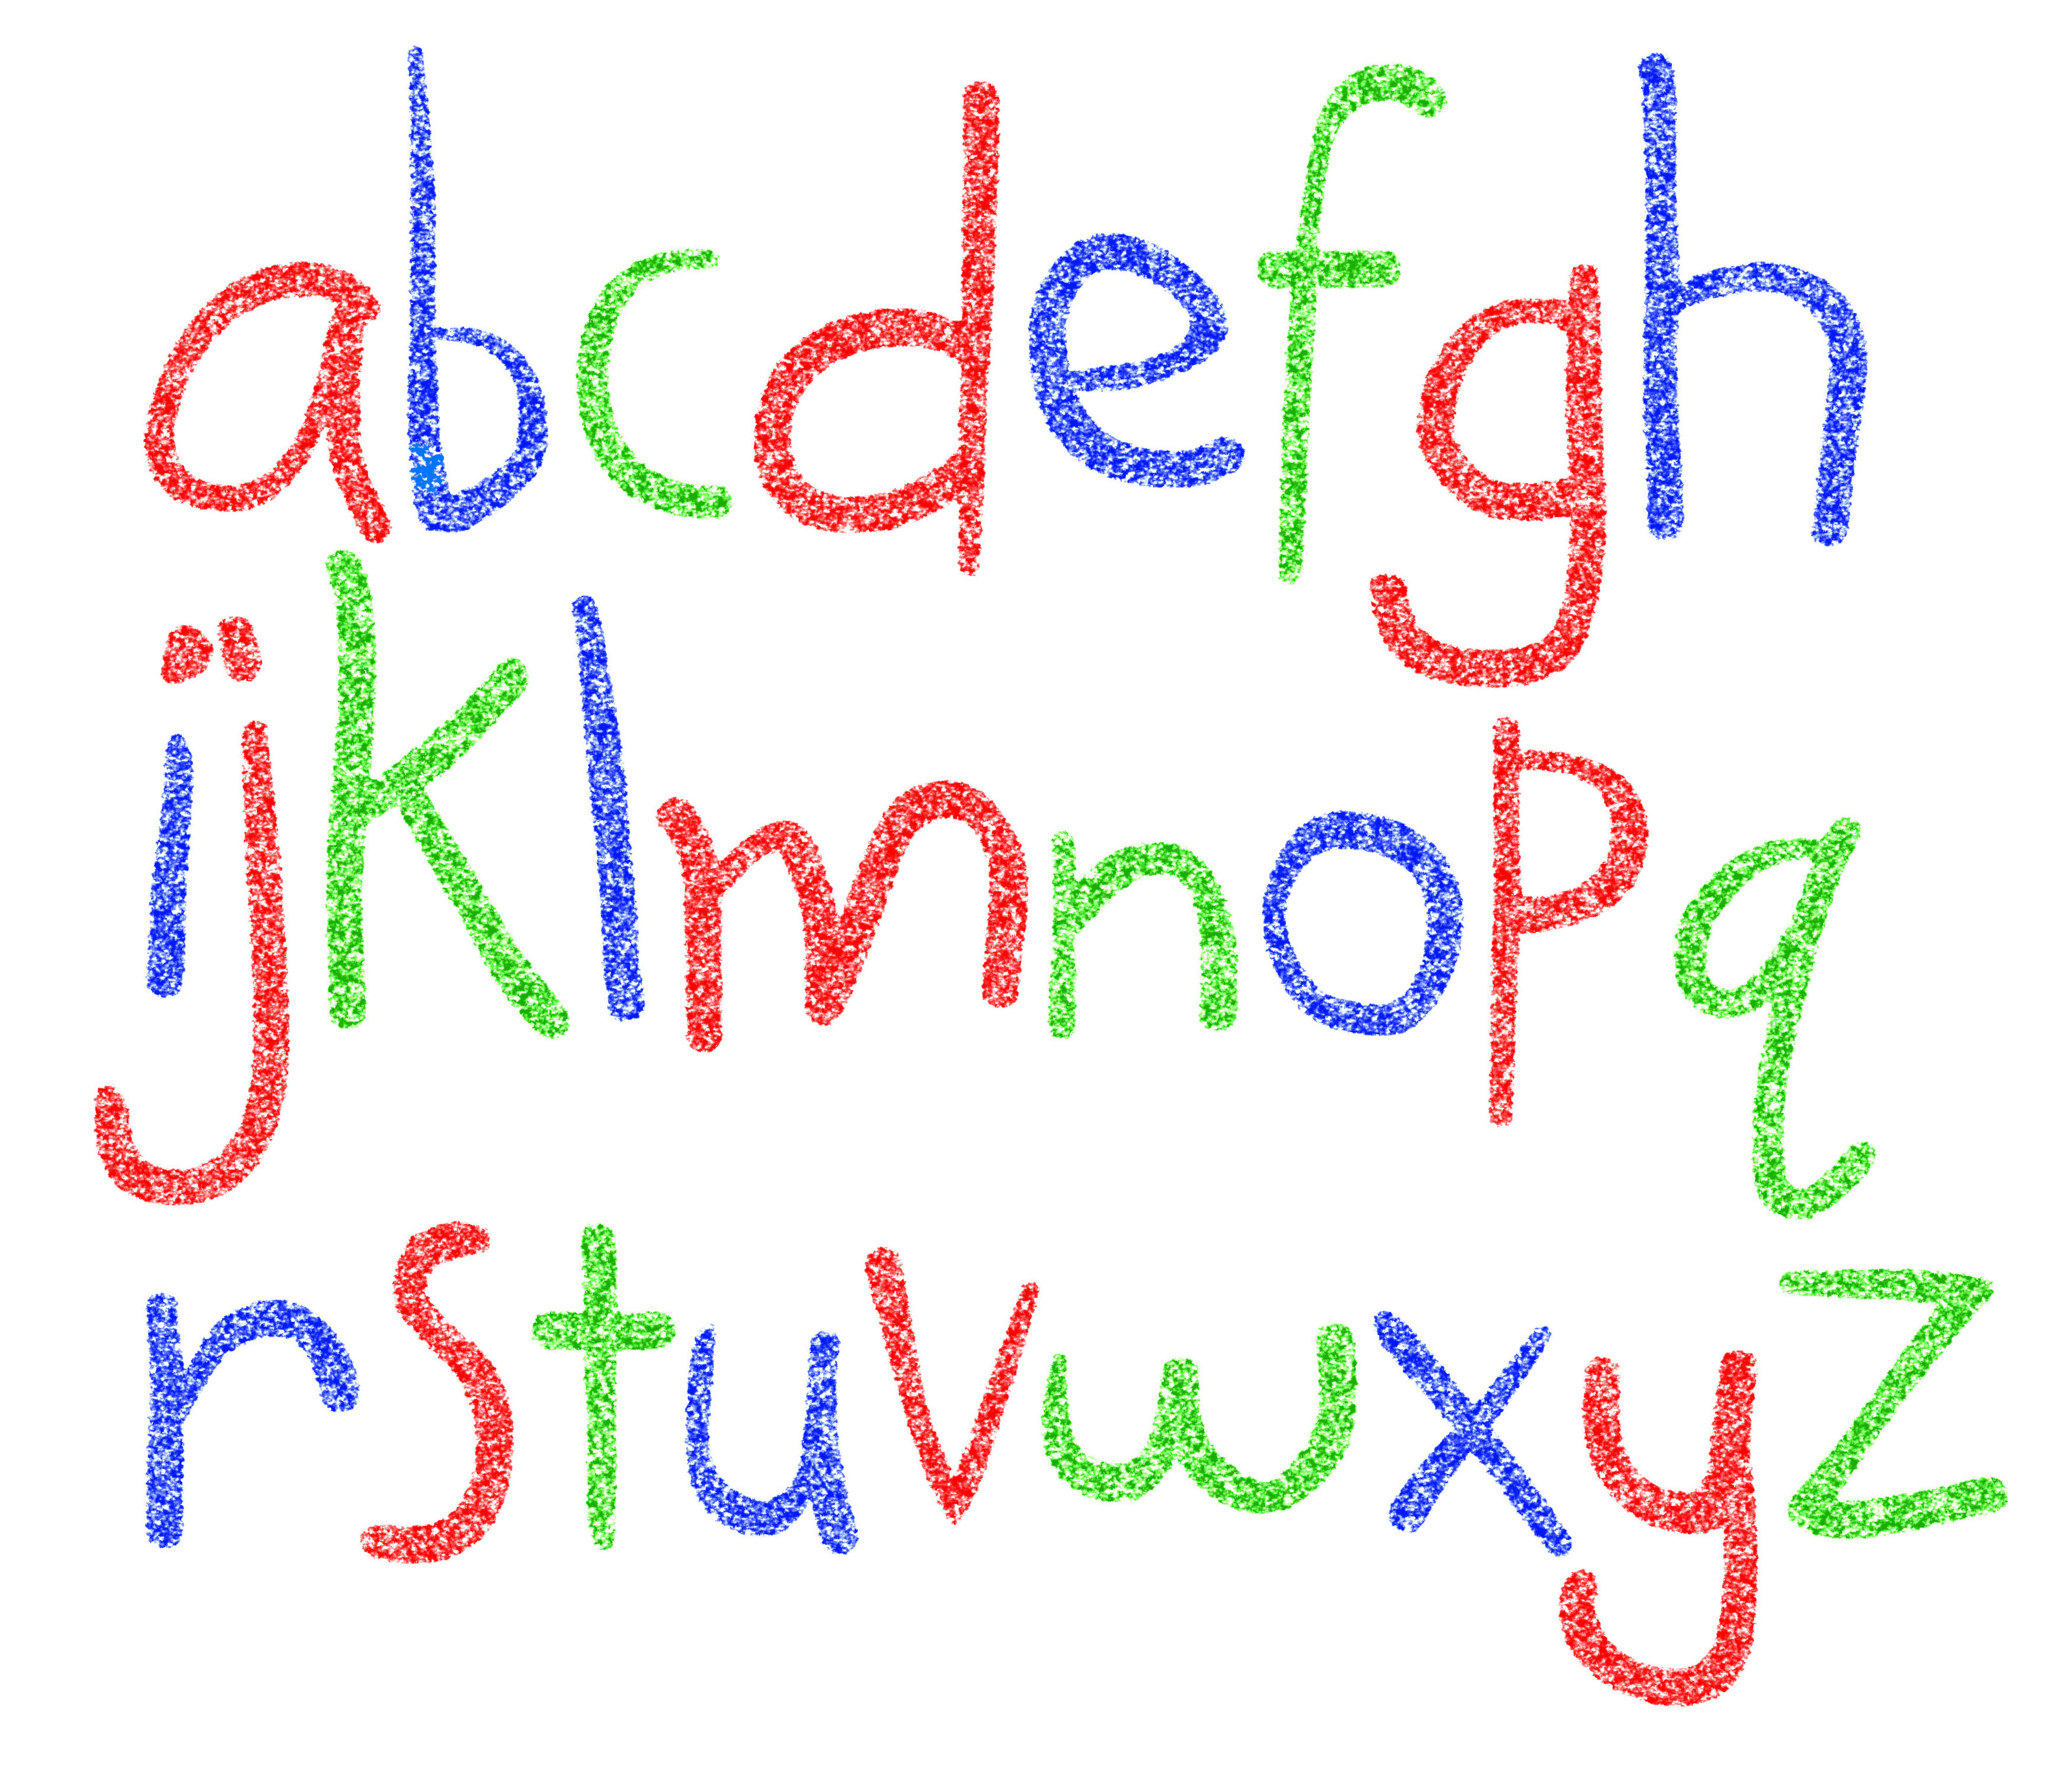
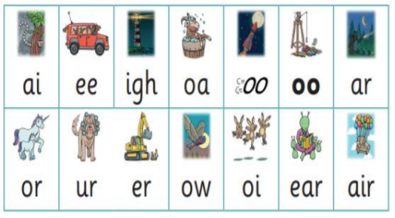

Did you know?
The English language has:-
26 letters
44 sounds
Over 100 different ways to spell
those sounds

Slide 6
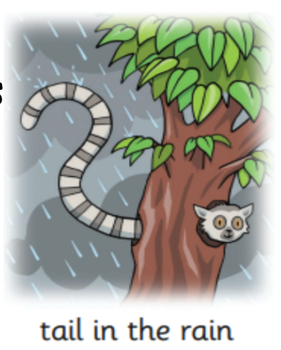
Did you know there are at least 8 ways to say the ai sound!
train
straight
tray
eight
a
they
cake
great

Slide 7
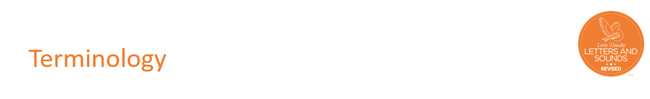
phoneme - Any one of the 44 sounds which make up words in the English language.
-grapheme – How a phoneme is written down. There can be more than one way to spell a phoneme. E.g-the phoneme ‘ay’ is spelt differently in each of the words ‘way’, ‘make’, ‘fail’, ‘great’, ‘sleigh’ and ‘lady’.
-blending – Putting together the sounds in a word in order to read it, e.g.
‘f – r – o – g, frog’
-Digraph- 2 letters making one sound
-Trigraph- 3 letters making one sound

Slide 8
How we teach phonics
Daily phonics sessions from Reception to Year 2
Correct pronunciation is vital - Videos on Little Wandle Website:
https://www.littlewandlelettersandsounds.org.uk/resources/for-parents/
Practice makes permanent

Slide 9
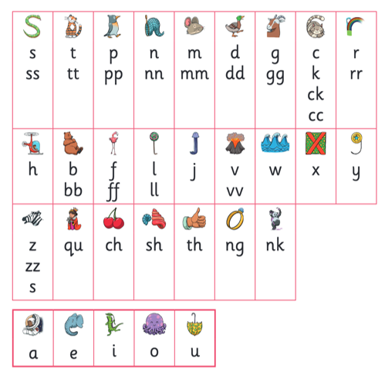
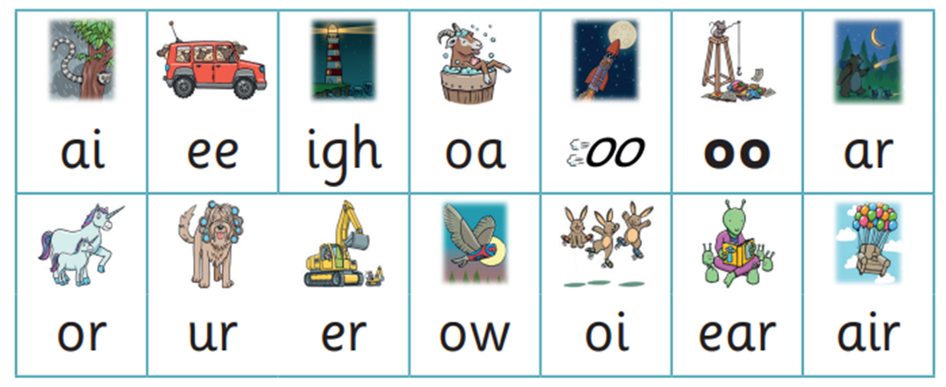
Sounds learned in Reception:
Notes:
Phonemes taught in order start to read words asap
LW has a picture pneumonic to help children remember the phoneme/grapheme

Slide 10
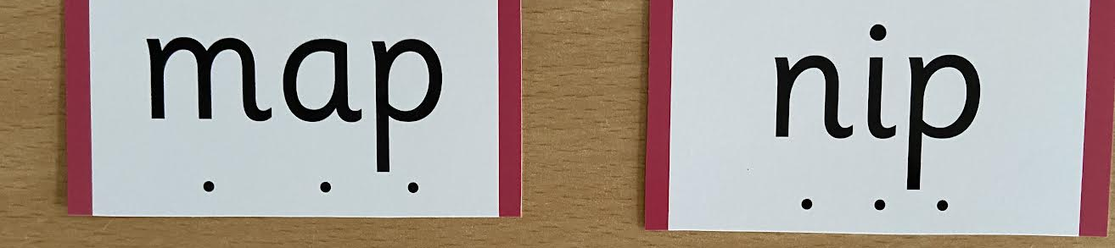

We use sound buttons to sound talk and blend each word.
Blending is where we sound talk each phoneme and put them together.
Notes:
During phonics lessons we use Sound buttons so we can sound talk and blend to read

Slide 11
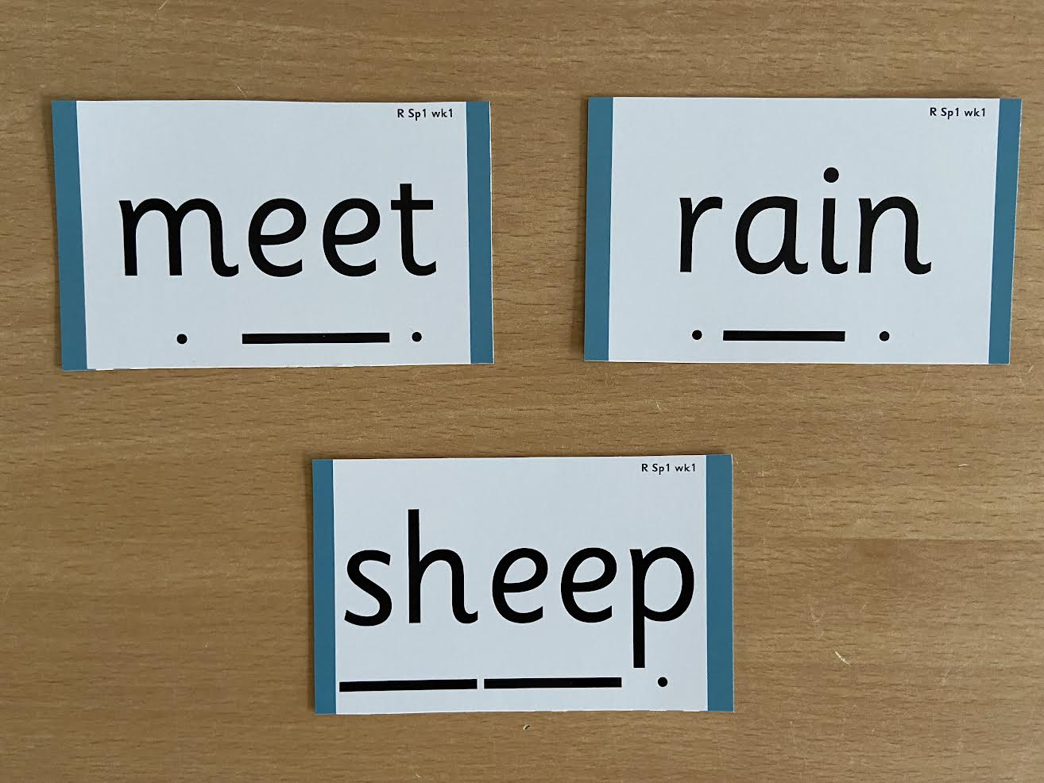
Digraphs and trigraphs have a line under them to make sure children say 1 sound for the grapheme.
Notes:
Digraphs have a zip to sound talk and blend

Slide 12

Tricky words are words that cannot be sounded out phonetically.
Notes:
Words that do not follow the rules and cannot be decoded – tricky words/ exception words
Chn are taught what part of the word is tricky

Slide 13
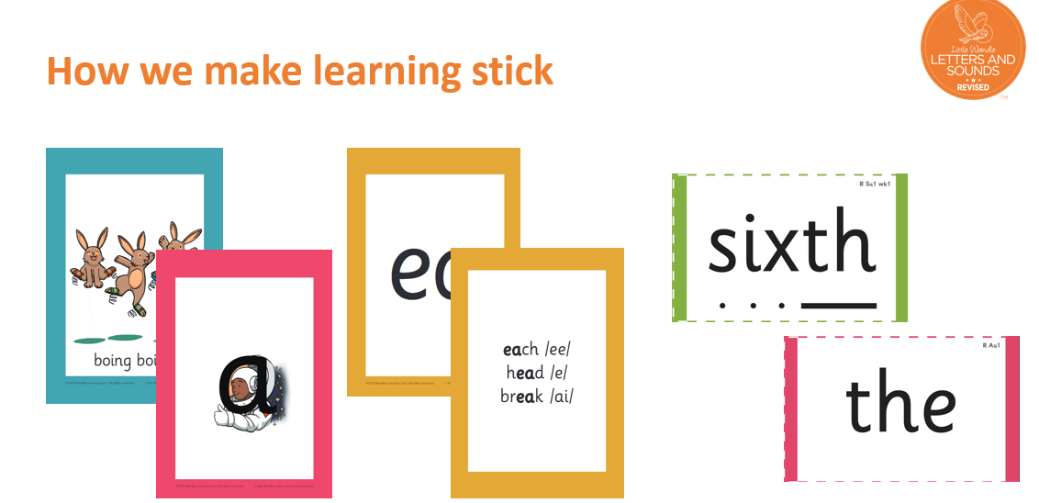
Each sound that we teach has either a mnemonic
‘Around the astronaut and down into space.’
Helps with handwriting practice.
Digraphs have phrases like boing-boing for ‘oi’. This helps the children recognise and remember the graphemes.

Slide 14
Additional Websites:
Websites for Phonics games:
Phonics Play - https://www.phonicsplay.co.uk/
Phonic Bloom - https://www.phonicsbloom.com/
Topmarks - https://www.topmarks.co.uk/english-games/5-7-years/letters-and-sounds
ICT Games -
ictgames || html5 English Games Page

Slide 15

Reading
We want children to
love reading
Learning to read should be
a positive experience
Reading should be
enjoyable
We want children to
read for pleasure
and be life
long readers.
Reading underpins children’s access to the curriculum
and clearly impacts on their achievement
Notes:
We all know how important learning to read is and the impact it has on a childs success - it has to be a positive experience
Whats the reality? Reluctant to read because they find it hard
Frustration stress tears – that’s just the parents
Important to look at the big long term picture

Slide 16

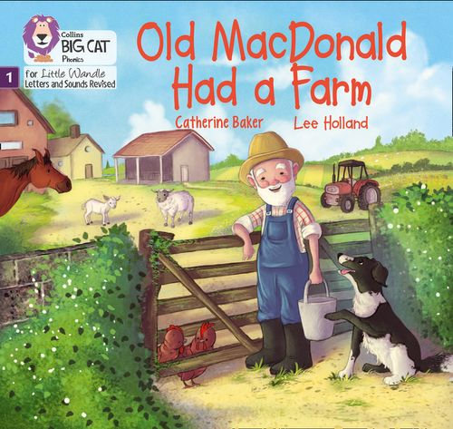

Once children have a secure knowledge of a number of GPC’s (Grapheme Phoneme Correspondences) and are confidently blending, they will be ready for reading books.
Prior to this they may have wordless books which develop great language skills and teach children the layout of books
and how to handle books.

Slide 17

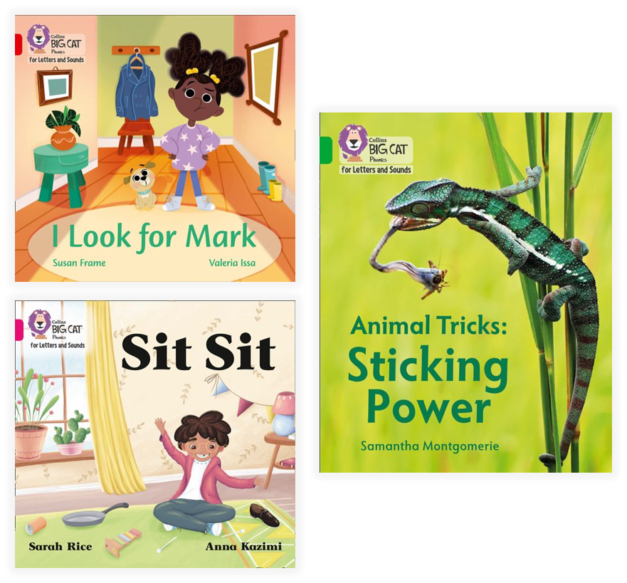
How we teach
reading
Reading practice sessions are :
Timetabled 3 times a week.
Matched to children’s
secure phonic knowledge
and word reading.
Taught in small groups.
Notes:
Quite a big difference to how reading was previously taught

Slide 18
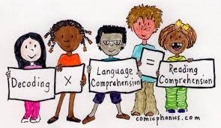
Reading Practice Books carefully matched so children can read
fluently and independently
3 Reads – each one begins with some quick sounds and
words practice
Decoding
Prosody
(intonation, expression)
3. Comprehension
When children take their book home to read they should be
95% fluent.
Please do not worry that a book is too easy – your child
needs to develop fluency and confidence in reading.
Re-reading a book they have had before helps develop
fluency – this is the goal.
Celebrate their success!!!

Slide 19


How do we decide which books
children read?
Children are assessed, then LW matches which books
Should be allocated for their secure phonic knowledge.
Children will take their Reading Practice Book home
(after reading it 3 times in school)
.
Share the front cover page before reading – this
covers sounds and words contained in the book.
Celebrate, praise, talk about the book with you child.
Please make sure books are in book bags every day.
Please look after our books – you may be charged if a
A book is damaged or lost.
Notes:
Children will not be changing book multiple times a week as previously
Reading groups will be set up so you will be notified of when your book will be sent home/ need to be back in school
Groups will change!

Slide 20





Supporting at home.
Reading for pleasure books
Children will also bring home a ‘reading for pleasure book’ from our class library each week.
To become lifelong readers, it is essential that they read for pleasure
Children may not be able to read this book independently but these books offer a wealth of opportunities for talking about the pictures and enjoying the story or information text.
Enjoy the book together and
foster a love of reading.

Slide 21
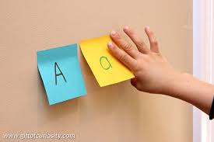
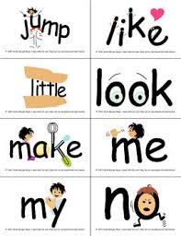
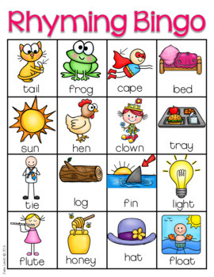
My child refuses to read at home
Take the sounds from the first page and put them on paper to play snap and make words –nonsense words are fun too!
Draw the words …
Play rhyming bingo – what rhymes with hat…
Matching pairs with the words from the first page.
Read it to them – pointing to the words.
Look at the pictures – talk about what is happening ‘make up a story’.

Slide 22
What else can parents do?
Please look at the Little Wandle videos and guidance for parents – nursery rhyme on the website help with rhyme and rhythm
Support children in learning the spellings or handwriting that is sent home.
Let your child “show off” their reading to you and celebrate and praise all the way!
Share books with your children for pleasure
Check on your class page for documents to support reading and phonics

Slide 23

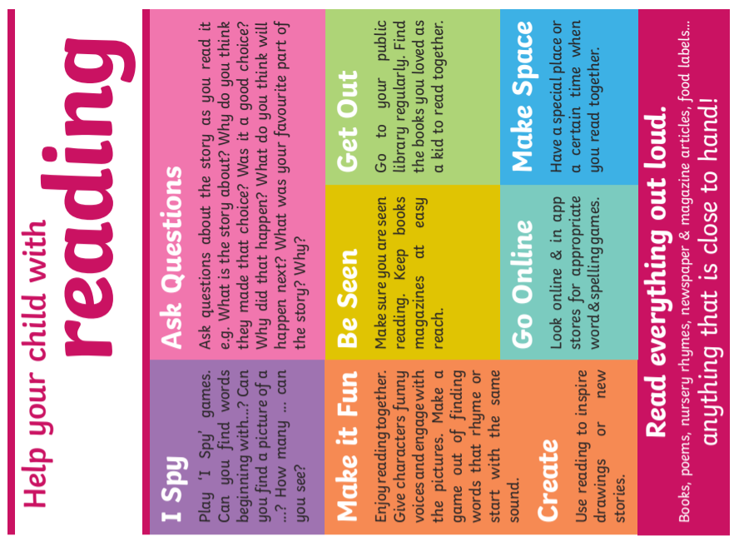
Phonics Play - https://www.phonicsplay.co.uk/
Phonic Bloom - https://www.phonicsbloom.com/

