Slide 1
Part 2

Slide 2
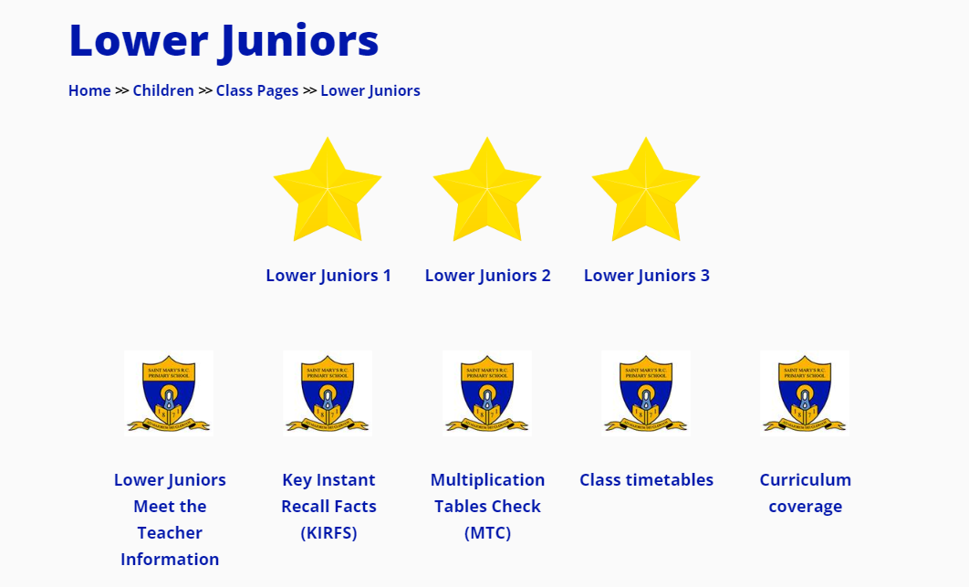
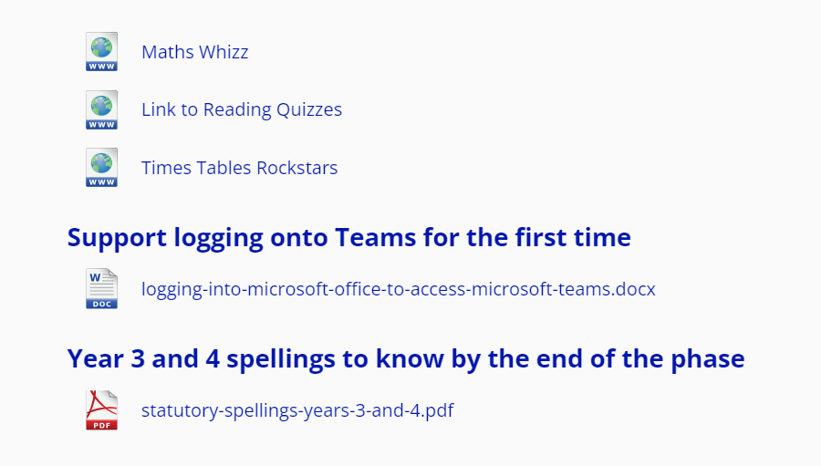
School Website
Follow this hyperlink to the school website:
St Mary’s Catholic Primary School Website
Select the tab Children – Class Pages – Lower Juniors

Slide 3
Homework: Assigned on Microsoft Teams (Please load TEAMS onto devices and sign in using email eg billy.jones@stmarys-maidenhead.org.uk with password)
Weekly homework
-Maths Whizz – 30 minutes per week (Monday – Sunday)
-Reading – 15 minutes per night reading to an adult and sign reading record. Child to quiz using AR platform when book is completed. Quizzing on books must be completed at home. Please see Reading Record for log in details.
-Spellings (Friday for Friday).
-Times tables or KIRFS (weekly low-stakes test)

Slide 4


Reading at Home - Expectations
Lower Juniors
Read every night with an adult for 15 mins
READING RECORDS MUST BE BROUGHT INTO SCHOOL EVERYDAY.

Slide 5

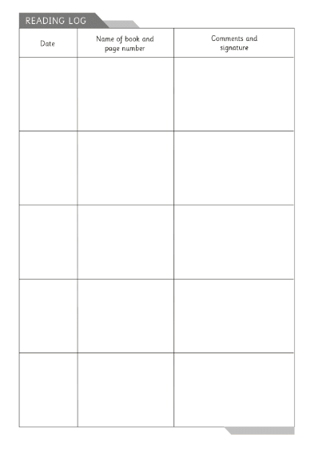
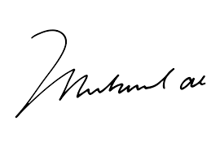
02.09.24
The Hobbit
Pg 6-10
Read with mum, discussed new word ‘rapidly’. Enjoying book.
Reading records should detail the pages covered and be completed by an adult.
Reading can include their own books/material from home.
Reading records will be checked and stamped daily in class.
Children who are identified as regularly missing home reading will be required to complete it during break time and parents will be contacted.
Reading records will also be stamped and completed when your child reads at school.

Slide 6

Juniors
Children will come home with a weekly library book aligned with their reading level
Children can complete quizzes on Renaissance based on books they are reading
Books will be changed once a week.

Slide 7
School Trips
Proposed trips/experiences
Autumn Term: Marwell Zoo, date TBC (mid Nov)
Spring Term: Ufton Court, Maidenhead Library, Three Workshops
Summer Term: TBC
(These are proposed trips and you will be notified of any updates)
Many trips/experiences will require a voluntary contribution and we will endeavour to give you as much notice.

Slide 8

Social media
The school website is where we aim to provide photos and updates on what is happening in the Infants.
Please follow us on Twitter
@mhstmarys
Please give your consent for photos of your child to be included

Slide 9
Medical Information
Medicines
Bring to the office
Medical form to be completed
Children shouldn't administer medicine themselves
Inhalers / epi pen
Medical labels on the box and the inhaler / epi pen
Ensure they are in school and in date
Sickness
Report to office
48 hours off for Sickness and Diarrhea.
Covid follow government guidelines – currently 3 days off school and until no longer unwell / with a temperature.

Slide 10
Communication
If you need to make the class teacher aware of anything in the morning, please send a note with your child or make contact via the school office - email / phone.
Any questions / queries or worries, please contact the class teacher first via the school office email - stmarysoffice@stmarys-maidenhead.org.uk
Keep an eye on Teams and emails – we will use these to contact you with any important updates
First person to speak with is your class teacher, then Mrs Conroy (Phase Lead)
Mrs White is our SENDCo (the best days to liaise with her are Tuesday and Wednesday)
Safeguarding concerns, please contact Mrs Akehurst or Deputy Safeguarding: Mrs Brown, Mrs Conroy or Miss Florez

Slide 11
Parent helpers
Reading volunteers!
(DBS is required)
Class Whatsapp – sign up at the end of the session if you wish.
Please let us know at the end of this meeting if you are interested or email the school office asap.

