Slide 1
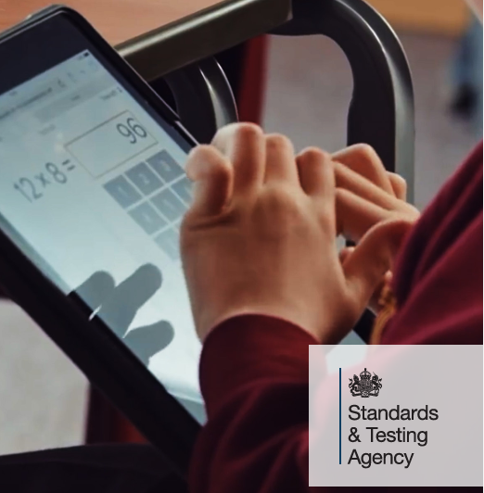
Multiplication Tables Check (MTC)

Slide 2

Guidance
The multiplication tables check (MTC) is a timed on-screen check consisting of 25 times tables questions, with 6 seconds for each question.
It is statutory for all year 4 pupils (unless there are extenuating circumstances)
The purpose of the MTC is to determine whether pupils can recall their times tables fluently, which is essential for future success in mathematics.
It will help schools to identify pupils who have not yet mastered their times tables, so that additional support can be provided.
There is no ‘pass mark’.
In 2025, schools must administer the MTC to all eligible year 4 pupils between Monday 2 June and Friday 13 June.
You child’s score will be shared with you in their end of year report.

Slide 3
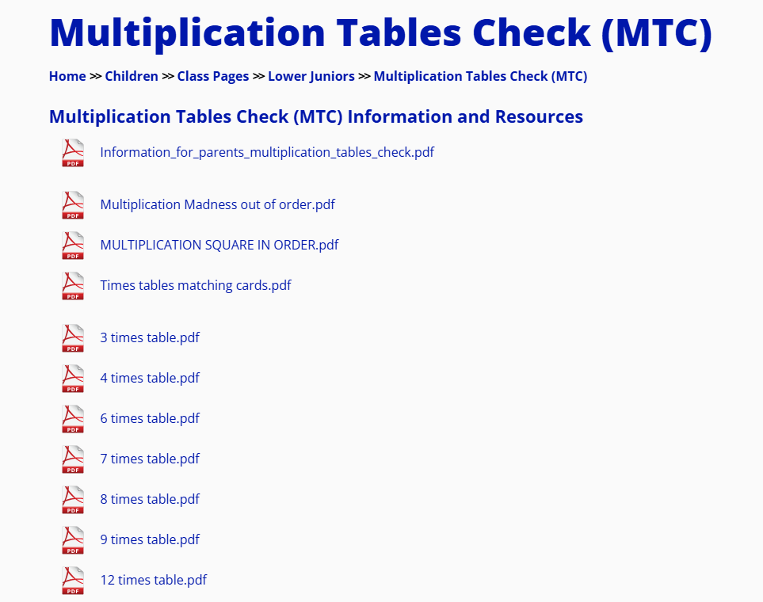


Slide 4
The children will have the opportunity to complete a practise test in the same conditions and using the same website.
Other sites that offer the same format of the test:
Maths Frame MTC
Times Tables MTC

Slide 5
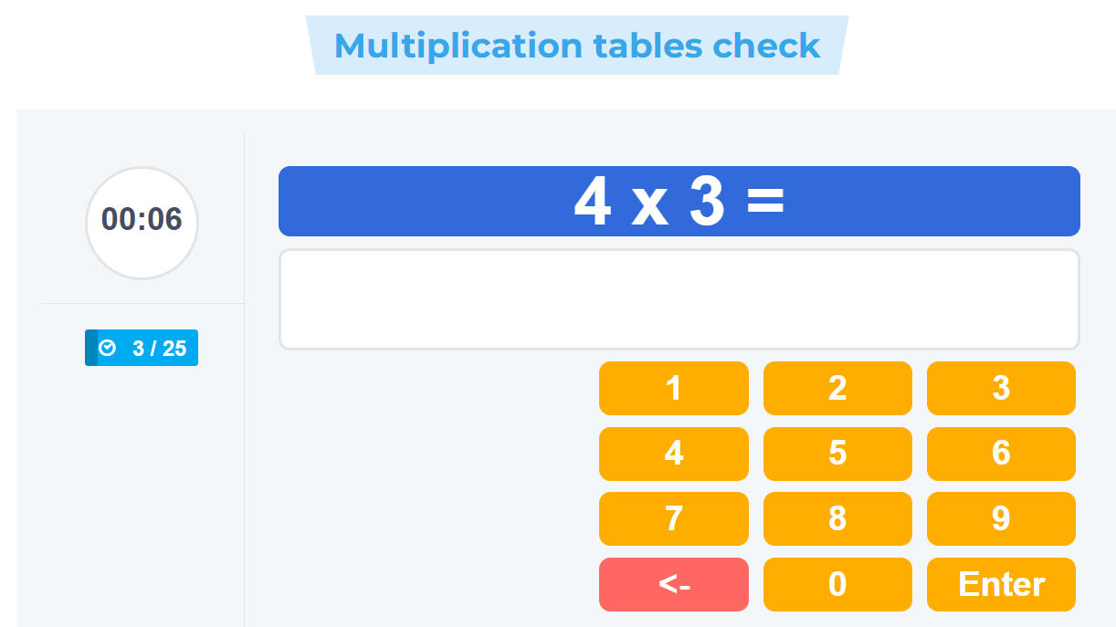
6 seconds per question
Times tables questions
25 questions
Keypad to
enter answers

Slide 6
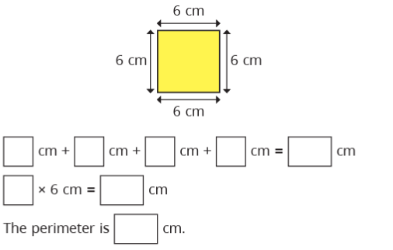
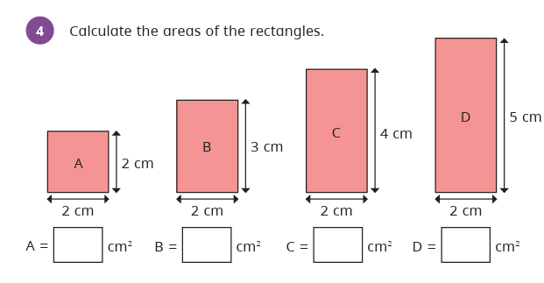
Why is knowing times tables so important?

Slide 7
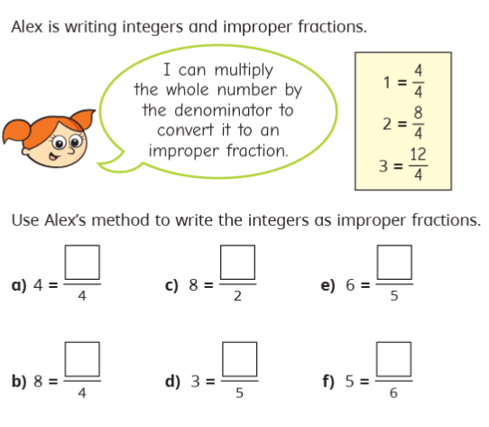
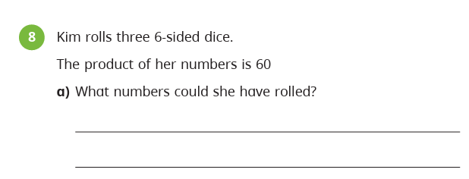
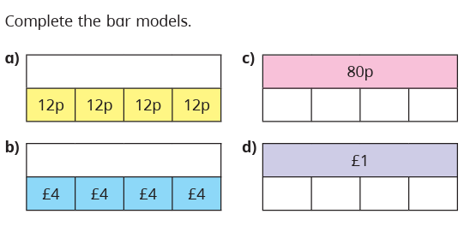
Why is knowing times tables so important?

Slide 8
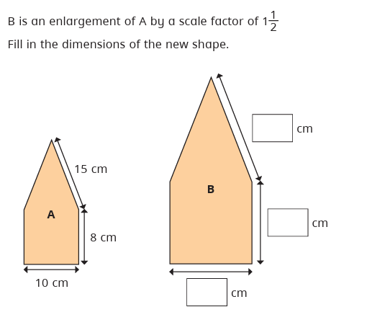
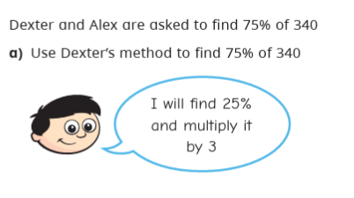
Why is knowing times tables so important?

Slide 9
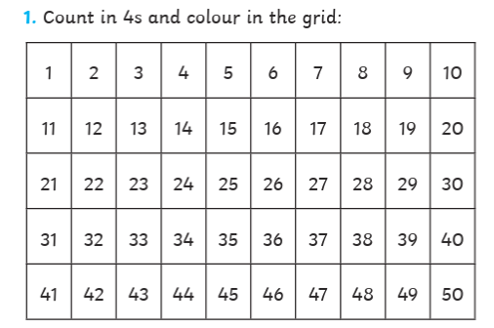
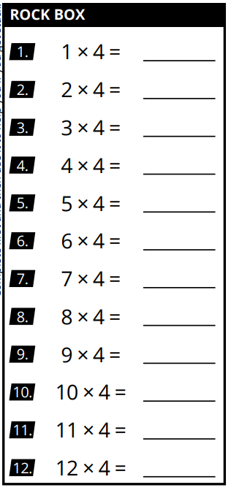
Techniques for learning a new set of times tables
Colour number square
Count in even steps forwards and backwards.
4, 8, 12, 16… 48, 44, 40, 36…
Practise times tables in order.
Match answers to questions.

Slide 10
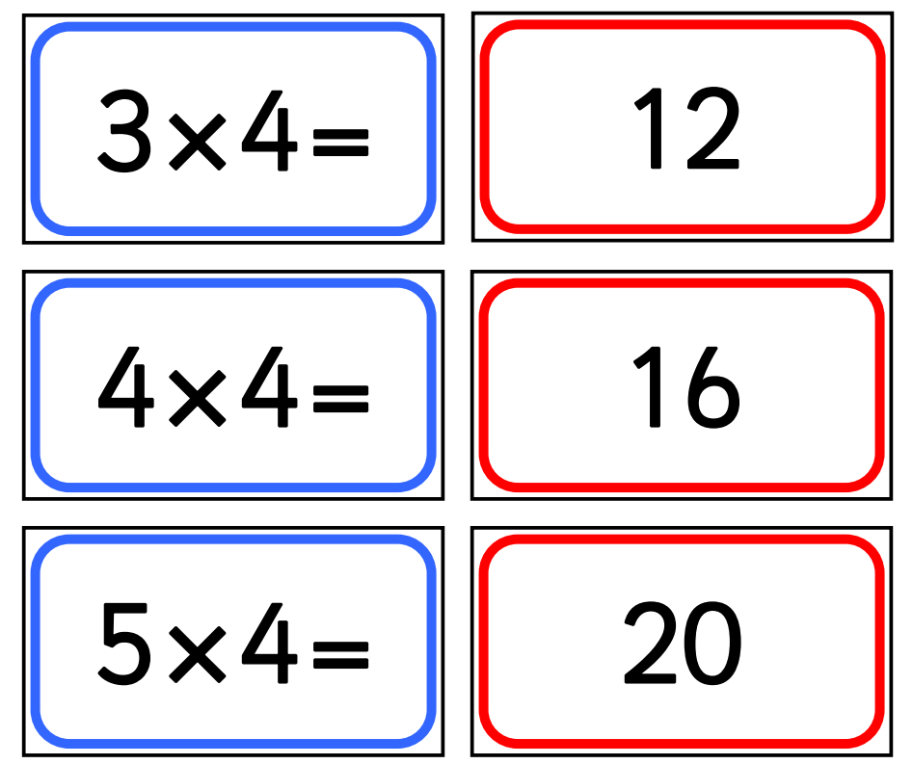

Slide 11
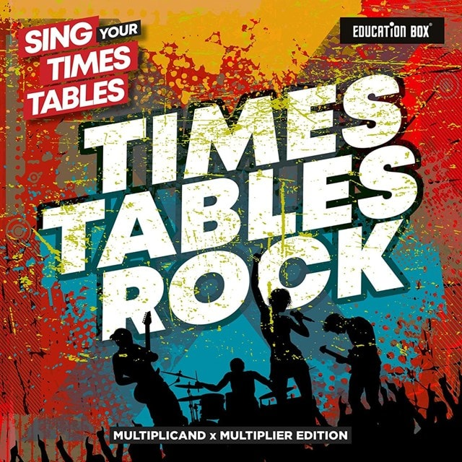
Techniques for learning a new set of times tables
Colour number square
Count in even steps forwards and backwards.
4, 8, 12, 16… 48, 44, 40, 36…
Practise times tables in order.
Match answers to questions.
Sing songs/raps.
Practise times tables out of order with corresponding ÷ facts
Play games to build speed.

Slide 12
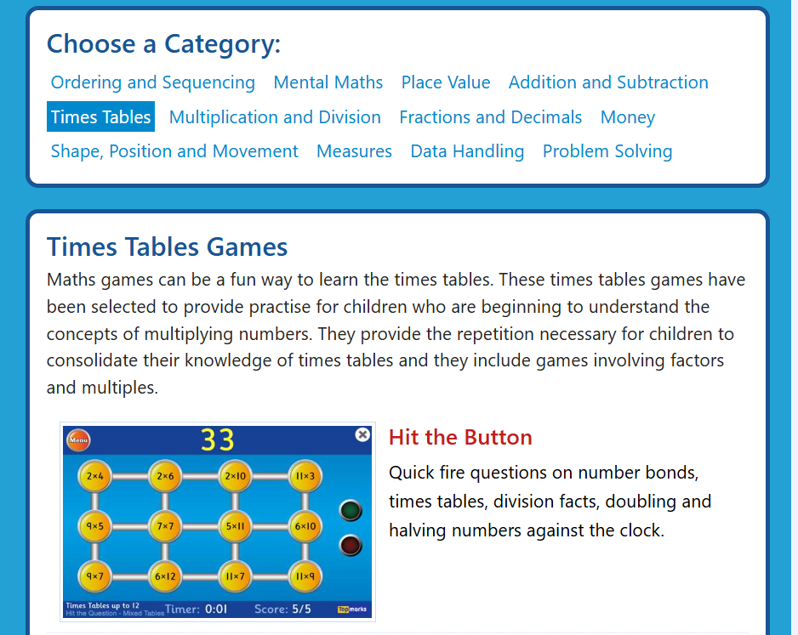
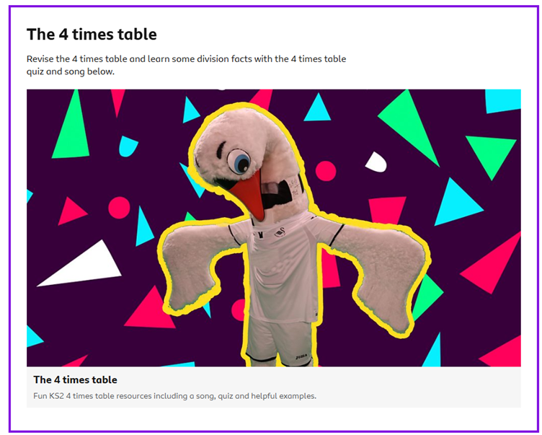
Online resources
Times Tables Rockstars
https://www.timestables.co.uk/
https://www.topmarks.co.uk/maths-games/7-11-years/times-tables
https://www.bbc.co.uk/bitesize/articles/z97rdnb#zw6k7v4

Slide 13
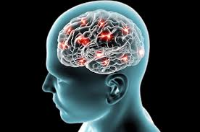
Pencil and paper resources on the school website.
Little and often is most effective.

Slide 14
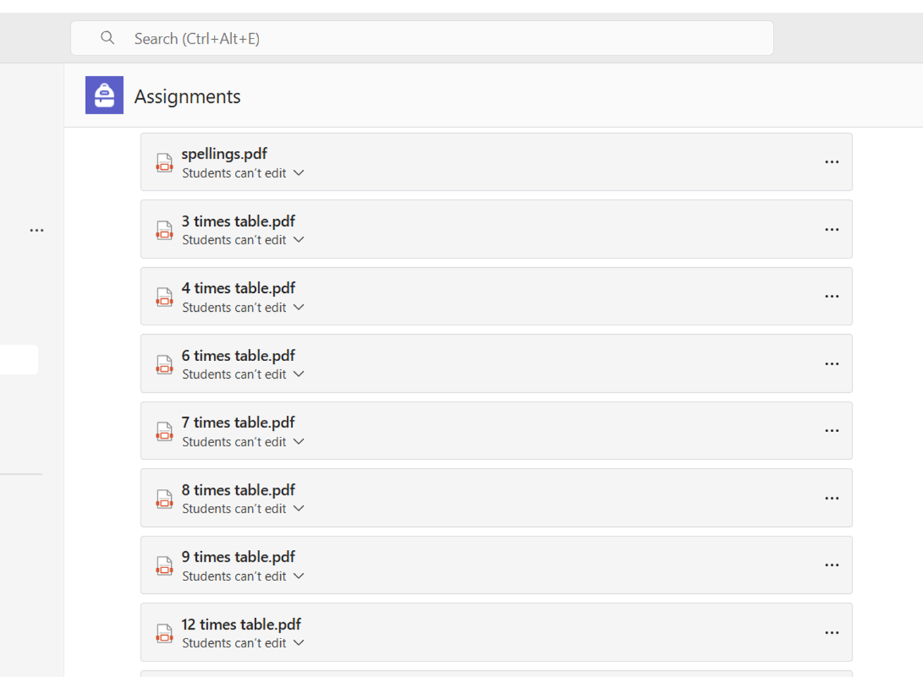

Homework
We will continue to teach and practise times tables in school and regularly assess which times table each individual child needs to focus on. We’ll let you know when they have a new focus so you can look out for their new slip.

Slide 15



