Slide 1


Slide 3
This shape is a ______.
square
This shape has ___ sides.
4

Slide 4
This shape is a ________.
rectangle
This shape has ___ sides.
4

Slide 5
Sort the shapes.
4 sides
not 4 sides

Slide 6
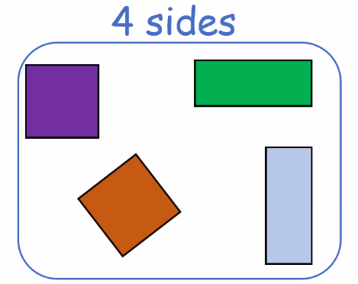
All these shapes have _______.
4 sides

Slide 7
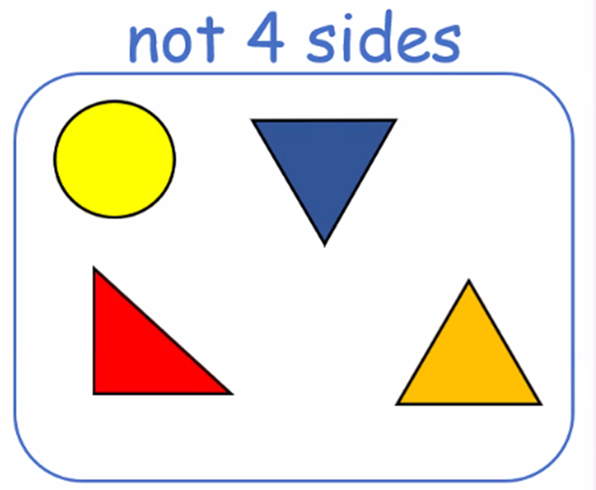
All these shapes do not have _______.
4 sides

Slide 8
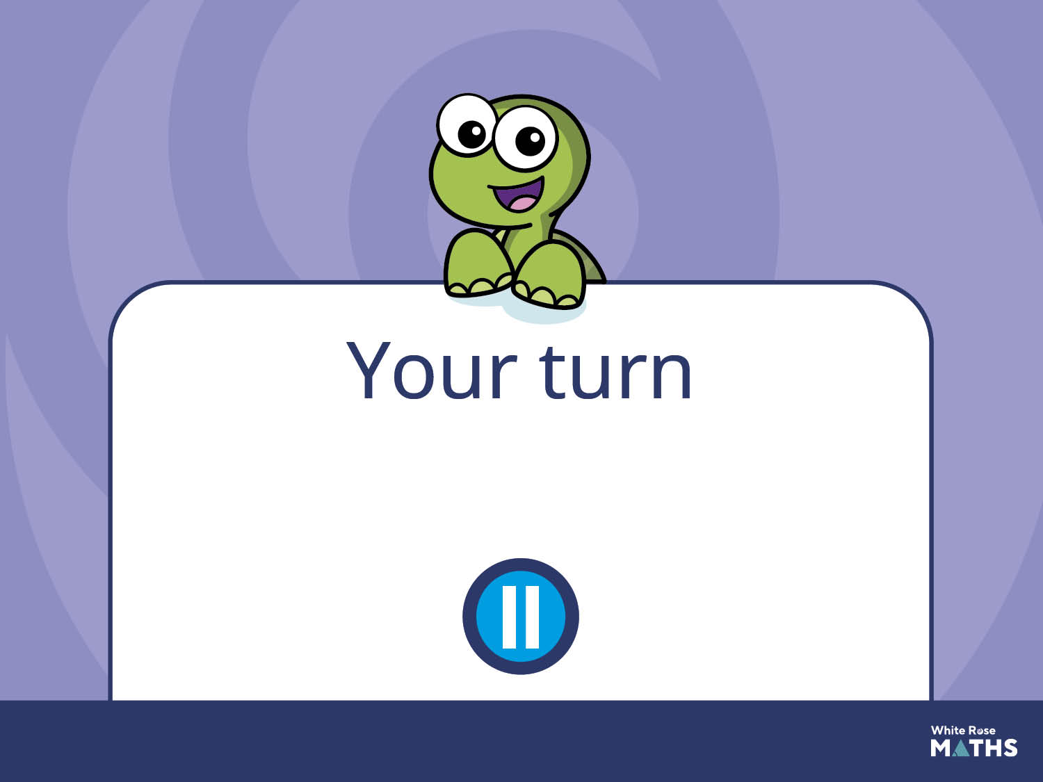
Have a go at the next activity.

Slide 9
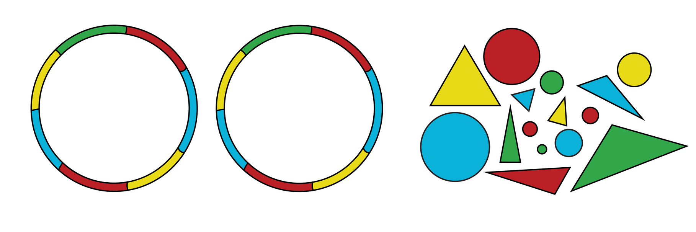
Hide a range of squares, rectangles, circles and triangles and provide 2 hoops.
Prompt children to find and sort
the shapes into those that have
4 sides and those that do not.

