Slide 1
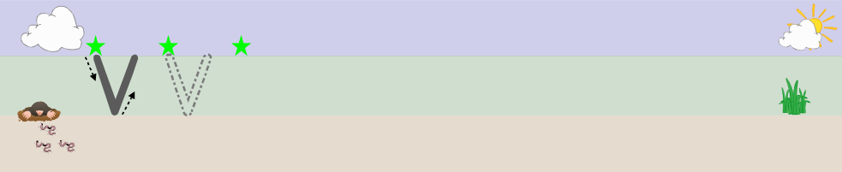

Slide 2
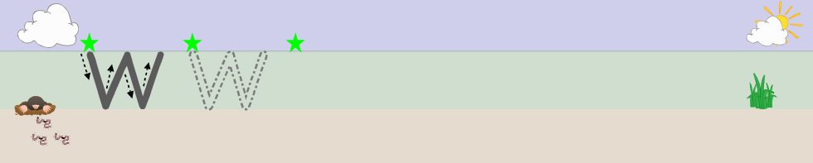

Slide 3
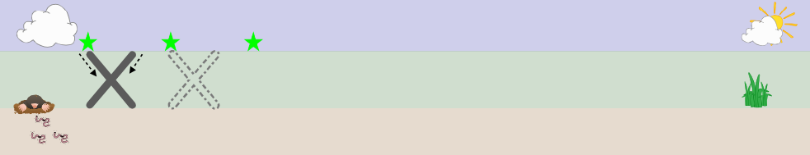

Slide 4
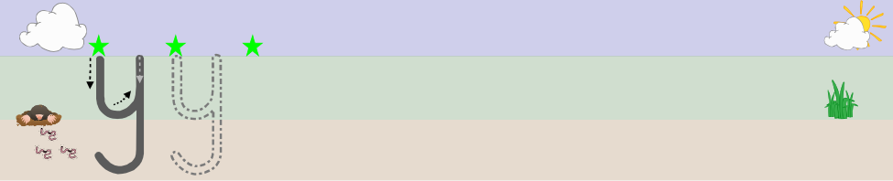

Slide 5
Friday alternate tasks:​
​
Link to drawing club – ​
Draw character and write character name​
Tricky word and number practice​
Teacher to follow little wandle spelling formation to help segment sounds for character name (if possible)​
​
Or​
​
Name practice

