Slide 1
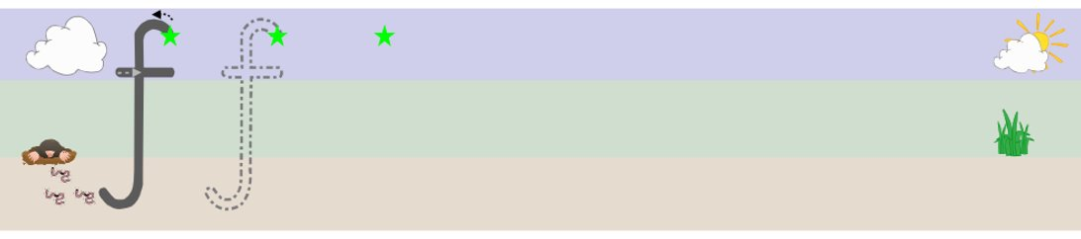

Slide 2
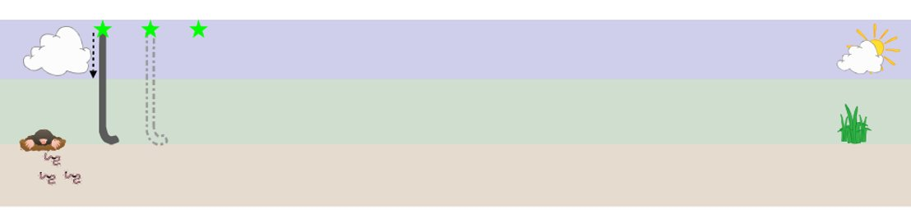

Slide 3
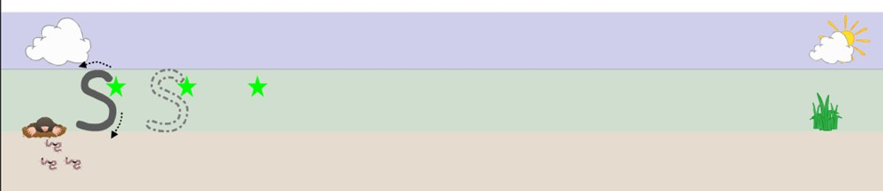

Slide 4
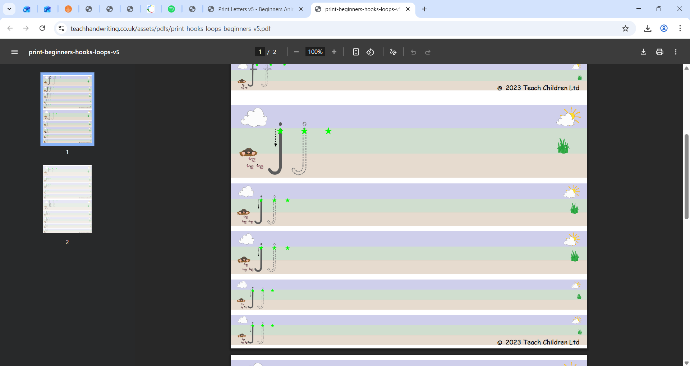

Slide 5
Friday alternate tasks:
Link to drawing club –
Draw character and write character name
Tricky word and number practice
Teacher to follow little wandle spelling formation to help segment sounds for character name (if possible)
Or
Name practice

